Slide 1

PBC HIV CARE Council New Member Orientation
2024

Slide 2

Mission of the CARE Council
“To establish a collaborative and balanced body of HIV infected and affected individuals, service providers, and community leaders and interested individuals whose responsibilities shall be to plan, develop, monitor, evaluate, and advocate for a medical and support service system for individuals and families affected by HIV.”

Slide 3

Vision Of The Care Council
A community where individuals who live with HIV/AIDS do so without prejudice, abandonment, or social stigma.
A community where people living with HIV/AIDS are afforded a comprehensive range of medical and support services assuring the person’s wellness, independence and self sufficiency.
A community where HIV medical and support services are eligibility accessed based upon need, and approved CARE Council guidelines.

Slide 4
Ryan White HIV/AIDS Treatment Modernization Act
Purpose:
To improve the quality and availability of care for low-income, uninsured, and underinsured individuals and families affected by HIV
The purpose of the CARE Act:
“Address the unmet care and treatment needs of persons living with HIV/AIDS by funding primary health care and support services that enhance access to and retention in care.” (From House Report 109-695)

Slide 5

Who was Ryan White?
Ryan White was a teenager from Indiana. He was diagnosed with HIV/AIDS in the mid 1980’s after receiving a blood infusion as a Hemophiliac. He and his family experienced severe prejudice. He worked to educate the public on the disease. In honor of Ryan White, the C.A.R.E. Act (now the HIV/AIDS Treatment Modernization Act) was passed in 1990.

Slide 6


What is the CARE Council?
Created as a result of the Ryan White Comprehensive AIDS Emergency Act (1990)
  Ryan White HIV/AIDS Program
Requires EMAS to have a planning organization that will oversee the Priorities & Allocations process for local RW funds
Appointed by the PBC Board of County Commissioners after being recommended by the CARE Council
  Interview and application process
  Three, 3-year renewable terms

Slide 7
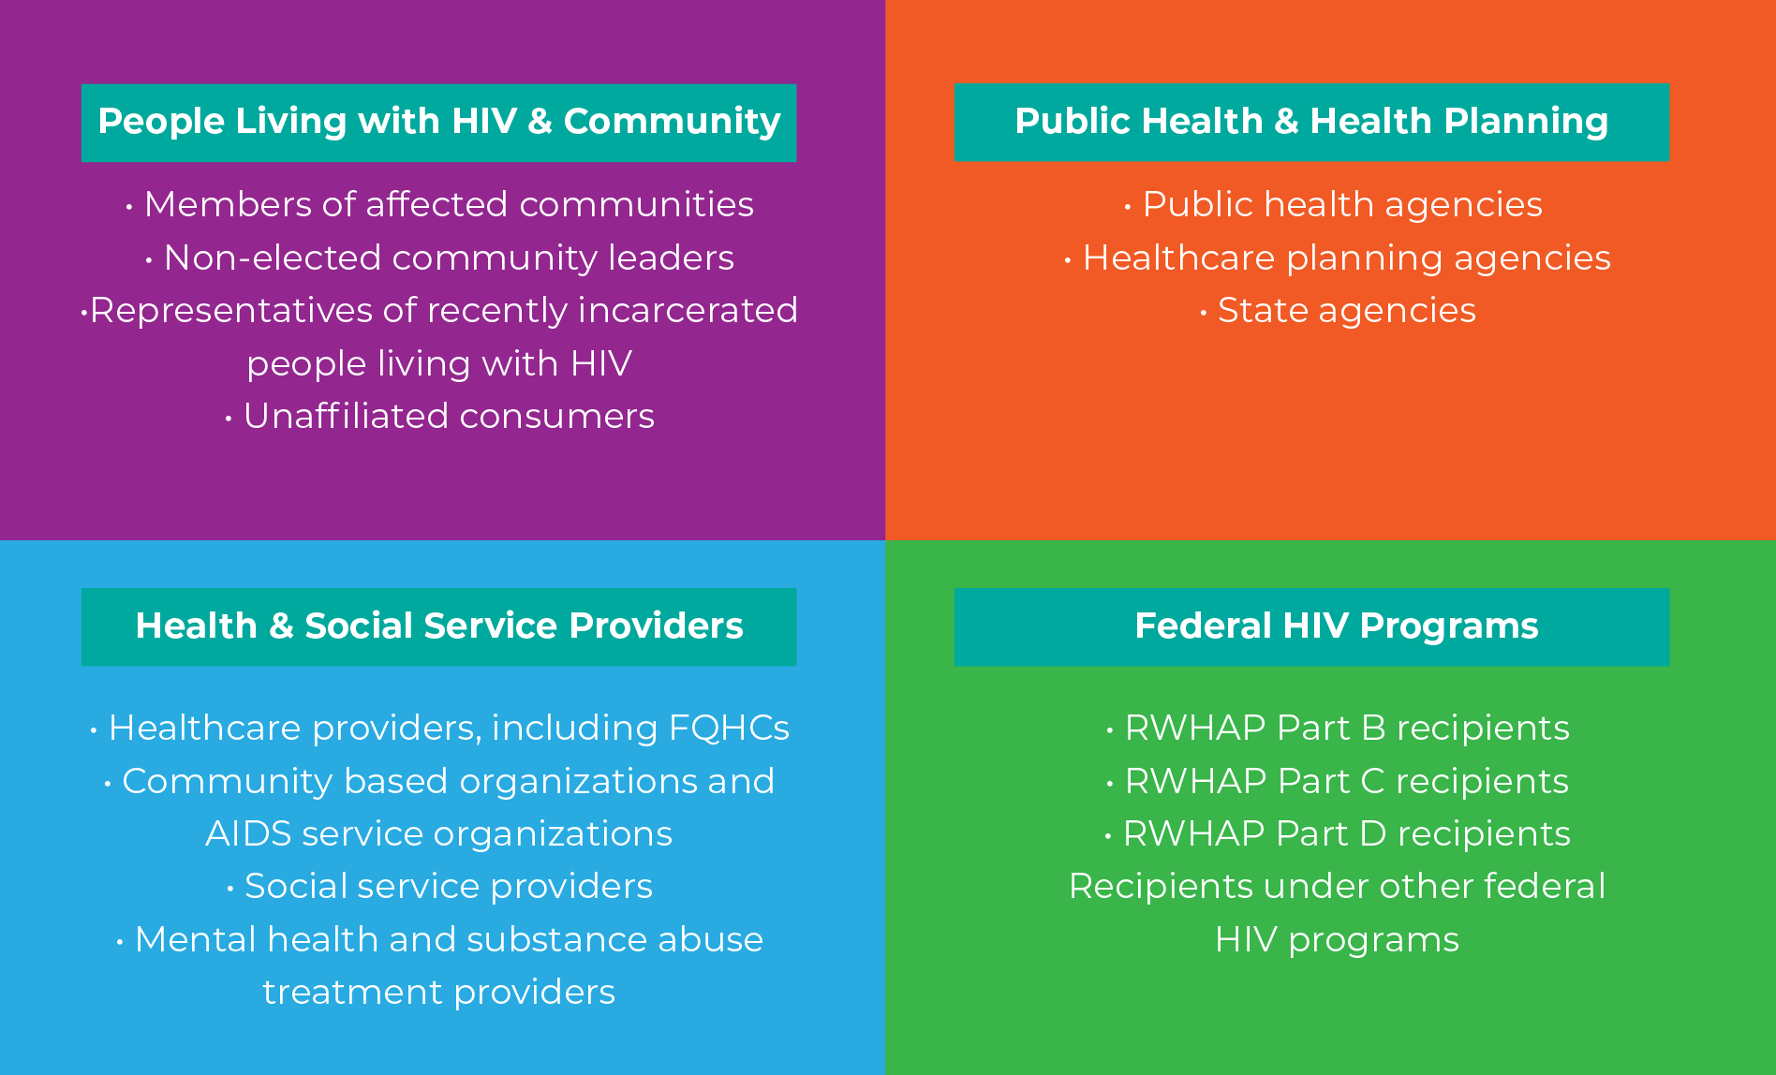
Who We Are…
Maximum of 27 members
Must reflect the epidemic in Palm Beach County
At least 1/3 of the members must be PLWHA who receive Part A services
A member may represent only one of the four mandated membership categories (Affected Community, Public Health & Health Planner, Federal HIV Program recipient, Health & Social Provider)

Slide 8

What We Do…
We annually update HIV/AIDS service needs in Palm Beach County by conducting a needs assessment
We develop and maintain Comprehensive HIV/AIDS Service Plan
We prioritize and allocate Ryan White Part A funds within Palm Beach County
We assure community participation in needs assessment and priority setting

Slide 9

What We Do
We assess the efficiency of administrative mechanisms in rapidly allocating funds to the areas of greatest need
We work with community members and other planning bodies to ensure a coordinated system of care
We maintain diversity and inclusion reflective of the epidemic in Palm Beach County in the Council membership
We assure services to women, infants, children and youth with the HIV disease

Slide 10

Membership Process
Once membership requirements have been met:
  Fill out an application
  Submit application to CARE Council staff
  Interview
  Approval by the Membership Committee -> Executive Committee ->CARE Council
  Approval by the Board of County Commissioners
  Members may serve a maximum of (3), three- year terms and must be renewed after each term.

Slide 11

To be considered for Membership:
1. Must be a Palm Beach County resident
2. Must attend one CARE Council meeting
3. Must become a member of at least one committee

Slide 12
Membership Information
Active committee participation
Quorum needed to vote on matters at a meeting
  CARE Council- 25% + 1 CARE Council member and at least 1 HIV+ member
  Committees- Chair or Vice-Chair + 2 member and at least 1 HIV+ member
  Executive- Chair or Vice-Chair + 3 member and at least 1 HIV+ member
  Ad-hoc- Chair or Vice-Chair + 2 members and at least 1 HIV+ member

Slide 13
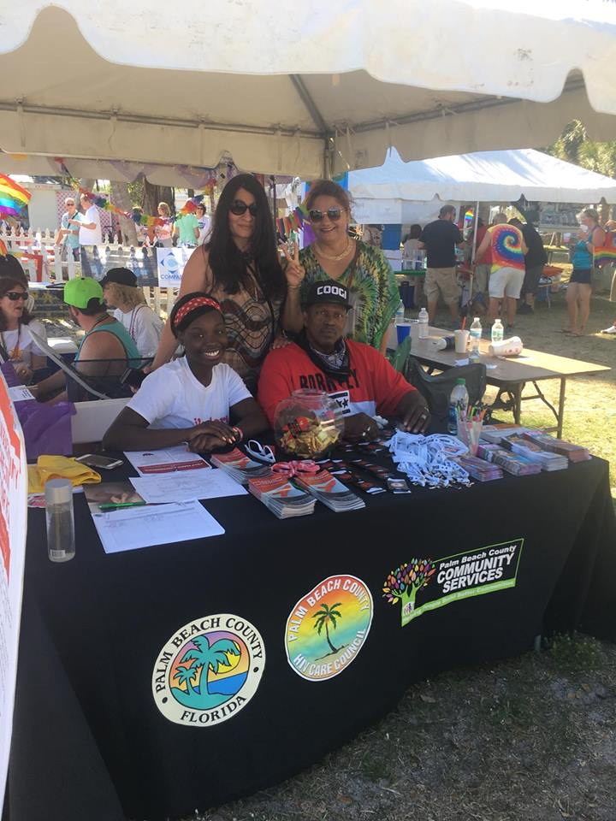
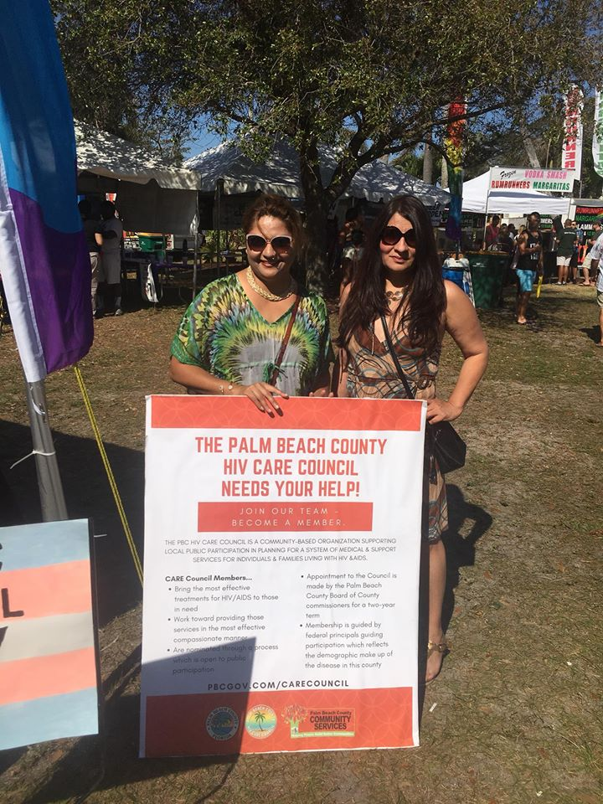
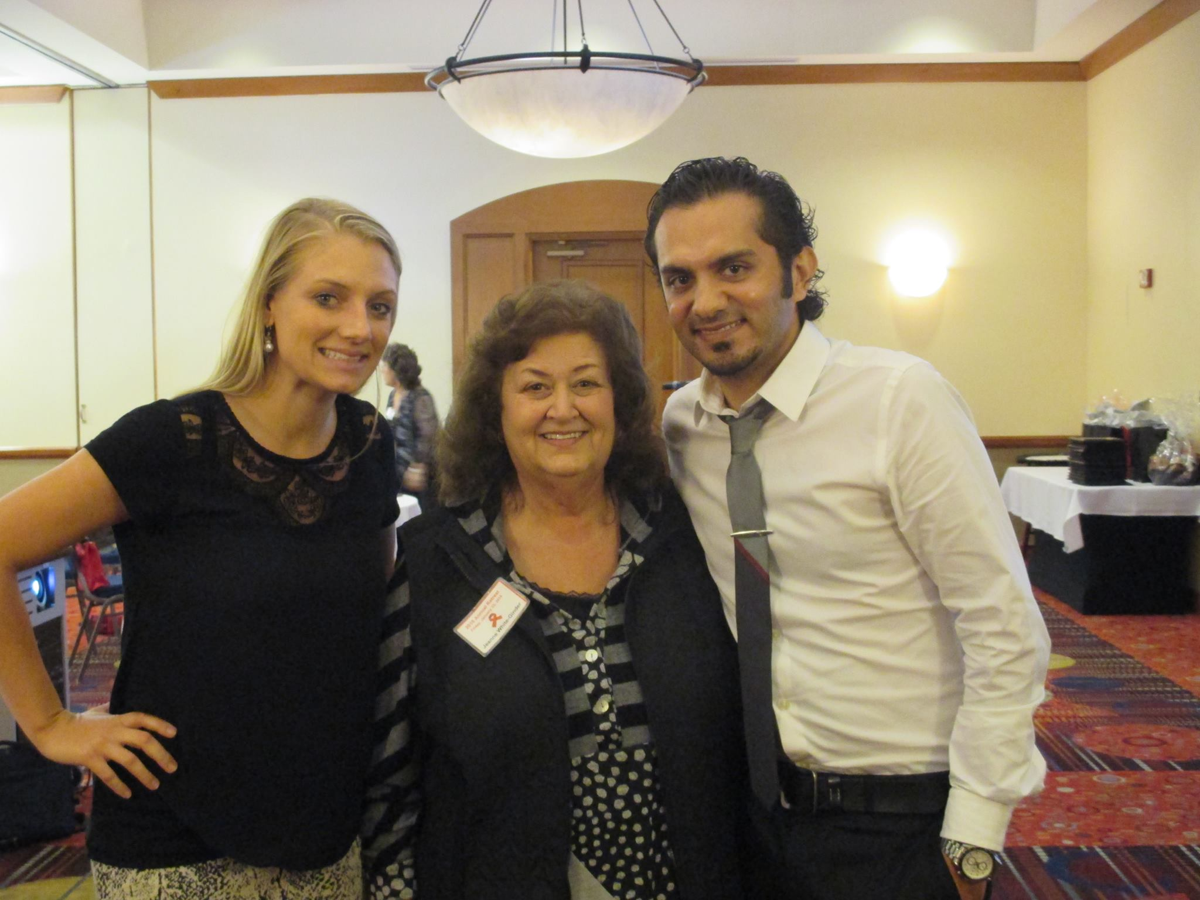
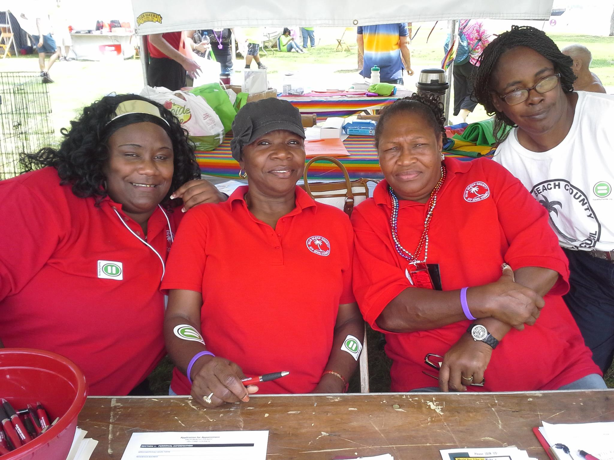
Other CARE Council Activities
Annual CARE Council Retreat
  Planning for the upcoming year
  Effective & efficient collaboration among agencies
Community Outreach events
  Testing
  Local agencies
  HIV/AIDS Awareness
Public forums
  Community discussions

Slide 14
Florida’s Sunshine Law,
Palm Beach County Code of
Ethics, Conflict Of Interest, and Gifts
Helene C. Hvizd
Palm Beach County Attorney’s Office
Senior Assistant County Attorney
561.355.2582

Slide 15
Palm Beach County Government and
The Ryan White HIV/AIDS CARE Council
Community Services Department
Palm Beach County Government
Ryan White Program
Ryan White HIV/AIDS CARE Council

Slide 16
Florida’s Sunshine Law
Florida’s Sunshine Law – Applies to any gathering of two (2) or more members of the same Palm Beach County Advisory Board to discuss some matter which will foreseeably come before that County Advisory Board for action.
The Ryan White HIV/AIDS CARE Council is a County Advisory Board
Sunshine Law - 3 Requirements
1. Meetings of public boards, commissions, advisory boards must be open to the public;
2. Reasonable notice of such meetings must be given; and
3. Minutes of the meetings must be taken and promptly recorded.

Slide 17
Florida’s Sunshine Law (continued)
Sunshine Law - E-mail, text messages, and other written communications between board members
The Sunshine Law requires boards to meet in public; boards may not take action on or engage in private discussions of board business via written correspondence, e-mails, text messages, or other electronic communications. See AGO 89-39 (members of a public board may not use computers to conduct private discussions among themselves about board business).

Slide 18
Florida’s Sunshine Law (continued)
Sunshine Law - E-mail, text messages, and Facebook
Example 1 – Dr. Messer (Ryan White Program Manager, County Employee) speaks to Kenny Talbot (CARE Council Chair) before a meeting about an agenda item
Example 2 – Helene emails Kenny Talbot (CARE Council Member), Neeta (CARE Council Coordinator), and Ashnika Ali (CARE Council Member) with a recipe for Ice Cream Bread
Example 3 – Helene conference calls Tyrina Pinkney (CARE Council Member) and Thomas McKissack (CARE Council member) about an agenda item
Example 4 – Kenny posts on facebook about an upcoming CARE Council event and Richardo Jackson (CARE Council Member) comments on the post

Slide 19
State of Florida Conflict of Interest
Section 112.3143, Florida Statutes
A person holding elective or appointive county office MUST ABSTAIN from voting on a measure which inures to his or her special private gain or loss, or the special private gain or loss of a relative or business associate.
You must publicly state the nature of your interest in the measure on which you are abstaining from voting and complete Form 8B.
Palm Beach County Code of Ethics
(http://www.palmbeachcountyethics.com)
Advisory board members may not participate in and vote on matters which give a special financial benefit to themselves, or those within a chain of relationships.

Slide 20
Palm Beach County Code of Ethics (continued)
Gifts
You may not accept more than $100 per year in gifts from a lobbyist, principal or employer of a lobbyist or person or entity that does business with your employer. In this case, the “employer” is the County.
Gifts from persons or entities which total more than $100 per year,
other than those prohibited, must be reported on a form. There are 11 gift exceptions.
Best Practice: Immediately refuse or return gifts from any County lobbyist, or principal or employer of a lobbyist, or person or entity that does business with the County.

Slide 21
Robert’s Rules of Order
What Is Parliamentary Procedure?
  Rules for conduct at meetings
  Allows everyone to be heard
  Decisions can be made without confusion
Why is Parliamentary Procedure Important?
  Allows us to-
    Stay on topic
    Be organized
    Conduct business in a timely fashion
    Motion (“I move we approve the agenda as presented.”); Second (“I second the motion.”); Discussion (“Is there any discussion on the motion on the floor?”); Vote (“Hearing no further discussion, all those in favor? All those opposed?”); Announce result (“The motion carries.”)

Slide 22
Order of Business

Slide 23


DATA FOR DECISION-MAKING
HIV Care Council for Palm Beach County
Daisy (Krakowiak) Wiebe, PhD, MPH
Quality Management Clinician
Palm Beach County Community Services
Ryan White Part A Program
DWiebe@pbcgov.org
(561) 355-4760
December 16, 2021

Slide 24

TRAINING AND EDUCATION
Epidemiology is the study of patterns, causes, and effects of health in defined populations
Dr. Daisy Wiebe is trained in data analysis, survey design, screening tool implementation, and evaluation of the effectiveness of interventions
Her role is to present and explain data in a clear and understandable way
I respond to requests for data and data presentations from the HIV Care Council
I am not a full member of the HIV Care Council and I do not vote or make the decisions

Slide 25

DECISION-MAKING
The HIV Care Council has the power to prioritize and allocate Ryan White Part A and Part B funds within Palm Beach County
How can decisions be made?
  Many things can influence how a decision is made, but if the goal is to have the largest meaningful impact for the greatest number of people living with HIV, three principles can guide you:
    Is the decision patient-centered?
    Is the decision outcomes oriented?
    Is the decision data driven?

Slide 26

Patient-centered
The goal is to improve the health and wellbeing of those who are living with HIV
Without considering how decisions will affect individuals and impact their lives, data and outcomes by themselves are meaningless
We can get input from consumers themselves, through the needs assessment, and direct participation on the council
We should always be thinking:
“How will this impact those living with HIV?”

Slide 27
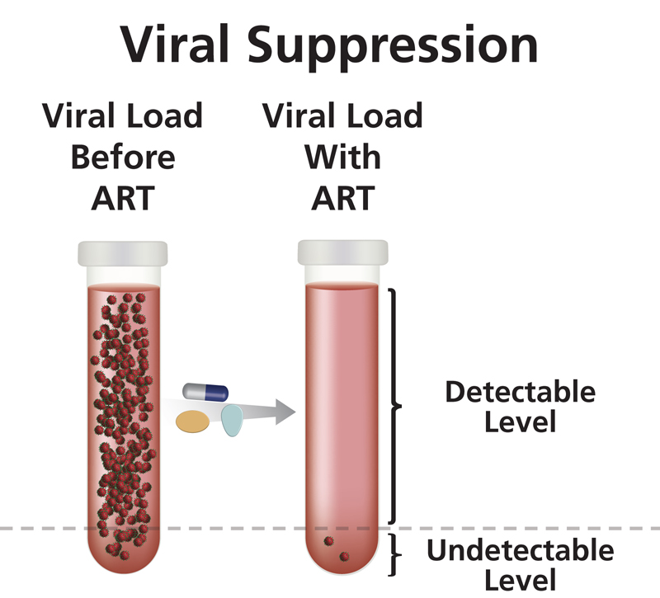
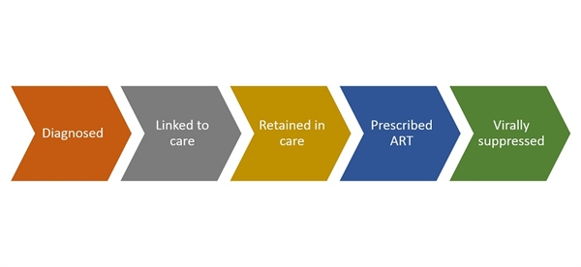
Outcomes oriented
Being outcomes oriented means you focus on what we know can actually make a difference in someone’s health (also known as evidence-based)
We focus on the HIV continuum of care, with the goal of viral load suppression because that means the virus is in very low levels in the body, and therefore good for the person’s overall health. Also, if you have an undetectable viral load, that means you cannot sexually transmit the virus to others (Undetectable=Untransmissable or U=U)

Slide 28
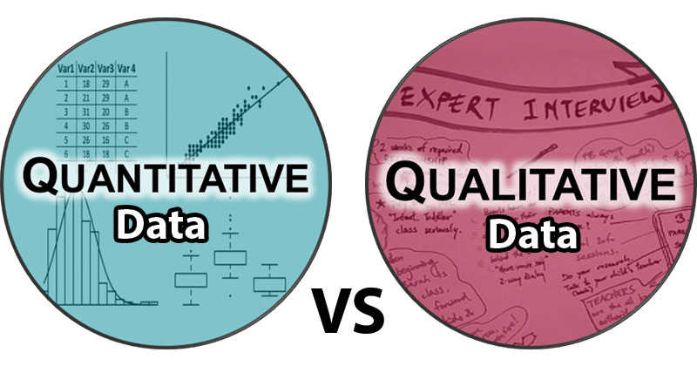
Data driven
Data is INFORMATION
Quantitative data are things you can count – i.e. NUMBERS
  Helps you understand WHO is experiencing gaps and disparities and in care, WHERE this is happening and WHEN things have happened
  Number of people not virally suppressed, among which groups
  Through collection of HIV clinic data, labs, prescriptions
Qualitative data are concepts and stories – i.e. WORDS
  Helps you understand WHY there are gaps and disparities in care and WHAT you might be able to address them
  Barriers and facilitators to care, ideas for interventions
  Through interviews and focus groups
Gap: where a person experiences a discrepancy between recommended best practices and the care that is actually provided due to issues of access, coordination or other barriers
Disparity: when demographic groups, based on race/ethnicity, gender, age, or other group-characteristic, experience lower health outcomes

Slide 29
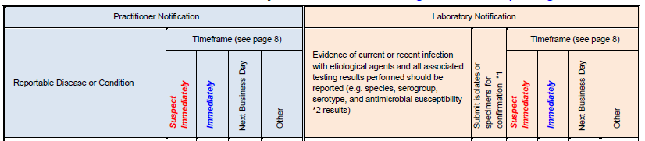
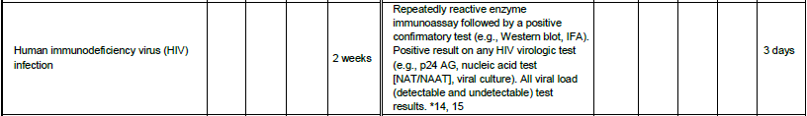
Data Reporting Requirements to Florida HIV Surveillance
Laboratories are required to submit test results electronically. For information about electronic laboratory reporting (ELR), please contact the Department’s ELR liaison at ELR@flhealth.gov.
Practitioners conducting in-house laboratory testing should review the laboratory reporting guidelines as well as practitioner guidelines to ensure compliance to aid in an effective and timely public health response.
http://www.floridahealth.gov/diseases-and-conditions/disease-reporting-and-management/faq.html#1

Slide 30


QUANTITATIVE data available
Palm Beach County HIV Care Continuum Data from Florida Department of Health
Ryan White Part A Provide Enterprise Data
  HIV care continuum and new diagnoses by year, race/ethnicity, national origin, gender, age, and transmission histories
  In August, we received more information on country of origin, missing viral loads vs. documented not virally suppressed and zip code data
  We have information on mental health, substance abuse, housing, food insecurity, transportation, social support, domestic violence, medical co-morbidities among Ryan White Part A clients (case management assessment)
  When clients come back to care, we also are recording the top reason for individuals being out of care

Slide 31
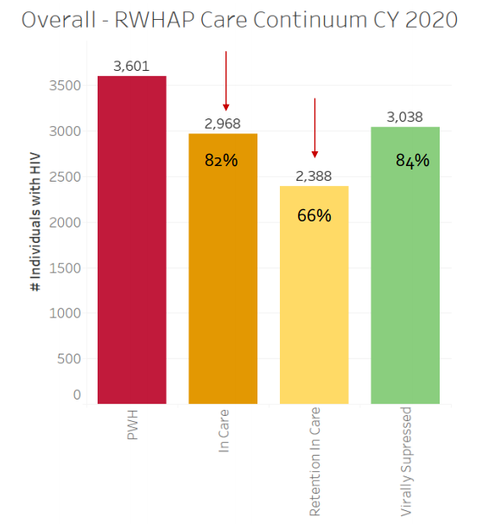
Data driven: Quantitative
It is important to consider how many people could be impacted with your decision
To impact the largest number of people, it is helpful to consider data
  Numbers of people
  Percentage of population
  Gaps in the continuum of care
  Disparities in the continuum of care
This information can help you target populations with the greatest need

Slide 32
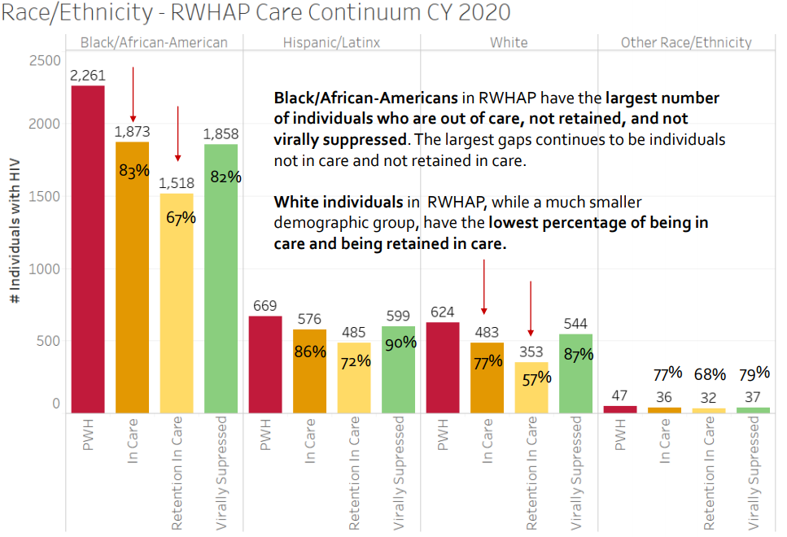
Understanding Numbers & percentages
Number of people
  How many people
Percentage of population
  Helps us to understand
  “of 100 people from this group, how many are _____?”
Visually, it is easier to compare and see gaps and differences using bar graphs instead of tables
Understanding graphs
Black In Care | Black Retention | Black Virally Suppressed | Hispanic In care | Hispanic Retention in Care | Hispanic Virally Suppressed | White In Care | White Retention in Care | White Virally Suppressed | Other In Care | Other Retention in Care | Other Virally Suppressed
83% | 67% | 82% | 86% | 72% | 90% | 77% | 57% | 87% | 77% | 68% | 79%

Slide 33
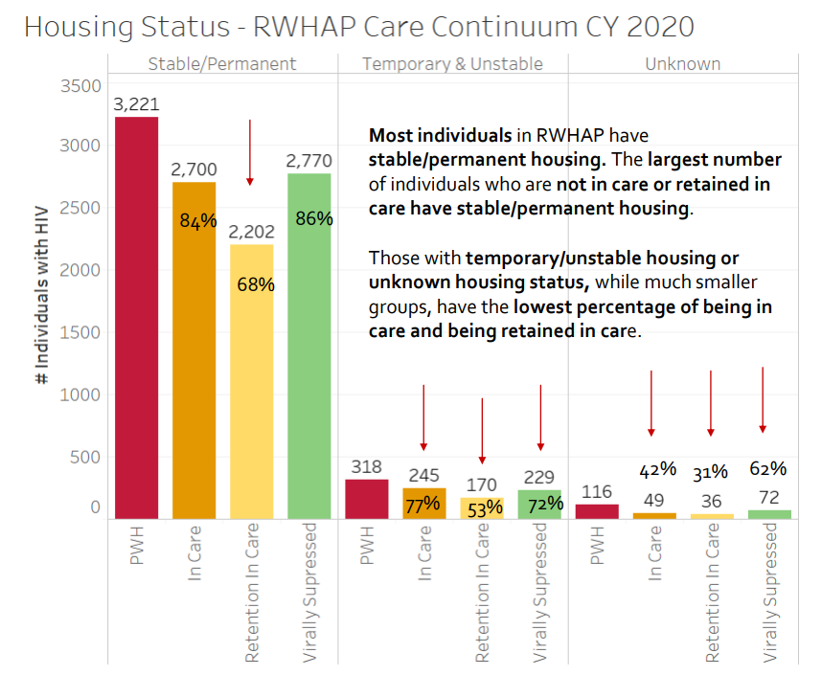

Slide 34
Additional data sources
Map data
  See which communities are impacted
    Focus on neighborhoods and communities
Studies and reports from other Ryan White interventions
  Interventions others have done to improve outcomes
    Can try it here and see if it works
Needs Assessment
Statewide Coordinated Statement of Need/Unmet Need
HAB Metrics, RSR Report

Slide 35
Ryan White HIV/AIDS Treatment Modernization Act- Just an example
GY Total Award: $ 7,500,000
Admin (10%) = $750,000
Care Council Support and Grantee Staff
CQM (5%) = 375,000
Provider Contracts = $ 6,375,000

Slide 36
FUNDING SOURCES
FORMULA
MINORITY AIDS INITIATIVE
SUPPLEMENTAL
  These funding sources are allocated on an annual basis.
  Received through HRSA – Health resources and Services Administration through a Notice of Award (NOA).
  CARRYOVER FUNDING – received in September if leftover funding from previous year is approved.

Slide 37
Care Council Member Duties
Care Council members have a special duty to allocate funding to Service Categories where need is greatest.
At Care Council meetings-monthly expenditure reports are presented to show status of expenditure for each service.
Expenditures reports will show which services are being used the most, which services are not being spent, etc.
At Mid-year the Priorities and Allocation Committee will re-allocate funding to Service Categories that have the most needs.

Slide 38
ANALYZING EXPENDITURE DATA
Initial vs. Final Contract Amounts
Last Month of Complete Reimbursement Data
Expected vs. Actual Level of Expenditure
Risk for Unobligated Balances (Carryover)
Overspending in Select Service Categories
75/25 Funding Restrictions and Sweeps Options
Efficiency of Services

Slide 39

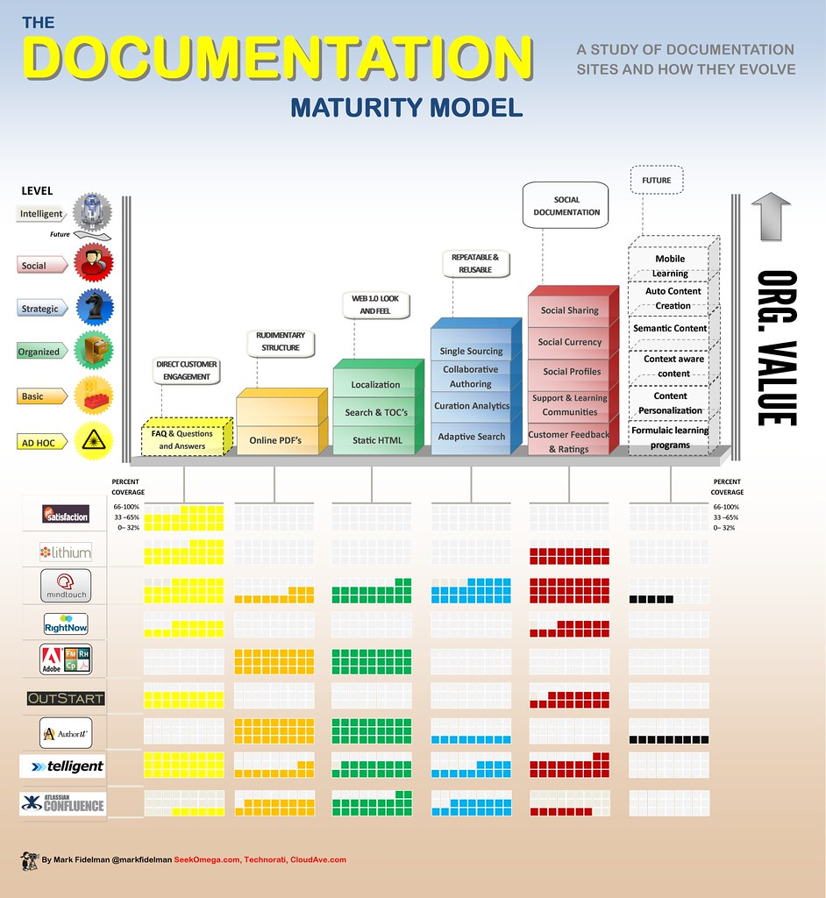
PROVIDE ENTERPRISE (PE) DATABASE
PROVIDE pulls actual usage/services from client records for payments.
Agencies submit their reimbursement requests for services provided through PE monthly.
These requests are for services provided to clients for various core and support services.
DOCUMENTATION IS REVIEWED FOR ACCURACY AND EITHER RETURNED FOR CORRECTIONS OR APPROVED.

Slide 40

SAMIS DATABASE
Reimbursements that are approved are submitted to the SAMIS database.
SAMIS is the database that ties the financial package together.
THE CHECK IS APPROVED AND SENT TO AGENCIES TO REIMBURSE THEM FOR THEIR WORK.

Slide 41
CARE Council Committees
Palm Beach County HIV CARE Council
Executive Committee*
Community Awareness
Planning
Quality Management & Evaluation
Local Pharmaceutical Assistance Program (LPAP)
* Membership
Priorities & Allocations **
LGBTQ Health
Ad Hoc Housing
*Limited to full CARE Council Members
**Limited to 15 members – Policy 21

Slide 44

Policies & Bylaws https://discover.pbcgov.org/carecouncil/Pages/default.aspx

Slide 45

Please Ask Questions
?

Slide 46


Neeta Mahani
Ryan White CARE Council Coordinator
810 Datura Street
West Palm Beach, Florida – 33401
Direct – (561) 355-4820
Email – Nmahani@pbcgov.org

Slide 47
