Slide 1



2023 HUD Continuum of Care (CoC) Homeless Local Renewal and New Projects Competition Notice of Funding Opportunity (NOFO)

Slide 2

  CoC Nofo Information
  Key Dates
  Guidance
  Noteworthy Changes
  Fatal Flaws
  Non-Conflict Grant Review Committee Meeting
  Local Priority Programs and Populations
  Application Checklists
  YHDP
  New Projects
  Scoring Tool
  Thresholds
  Available Dollars
  Programs to be Rellocated
  Reallocation Practices
  NOFO Process
  Staff Contact
  SAMIS Presentation
  Questions
Agenda

Slide 3
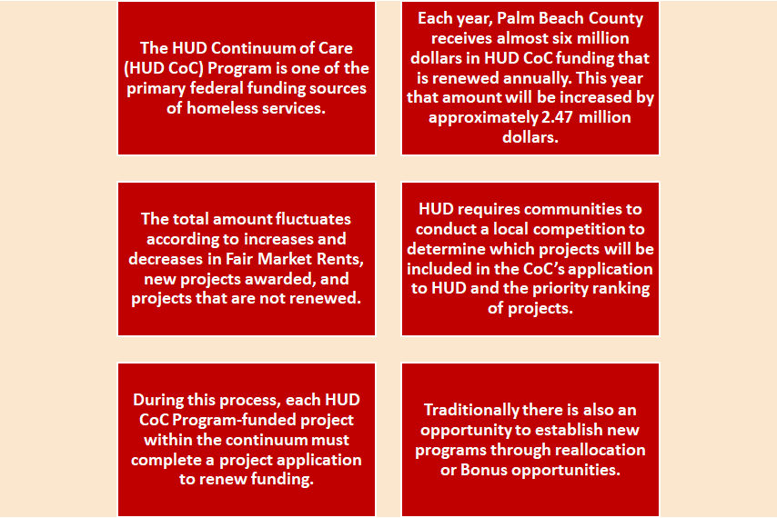
Each year, Palm Beach County receives several million dollars in HUD CoC funding that is renewed annually. This year there is approximately 7.8 million dollars available for renewal programs.
CoC NOFO Information

Slide 4


Application Release Date: July 28, 2023
Application Due Date: August 28, 2023 12:00 PM
CoC Non-Conflict Grant (NCG) Review Committee Meeting: September 6, 2023, 9:00AM TO 4:00PM
Grievance Submission Deadline: September 11,
2023
Application Submission Online at: https://pbcc.samis.io/go/nofo/
Late applications will not be accepted.

Slide 5


The NOFO email is:
CSD-COCNOFO@PBCGOV.org
HHA Website is located at:
https://discover.pbcgov.org/communityservices/humanservices/Pages/CoC-Grant-Apps.aspx
The Cone of Silence is in effect as of the submittal deadline of August 28, 2023 and shall terminate at the time that the PBC BCC signs the CoC Program Competition Application.
"Cone of Silence" means a prohibition on any non-written communication regarding this NOFO between any applicant or applicant's representative and any County Commissioner or Commissioners staff, any member of a local governing body or the member's staff, a mayor or chief executive officer that is not a member of a local governing body or the mayor or chief executive officer that is not a member o a local governing body or the mayor or chief executive officer's staff, or any employee authorized to act on behalf of the Commission or local governing body to award a contract.

Slide 6

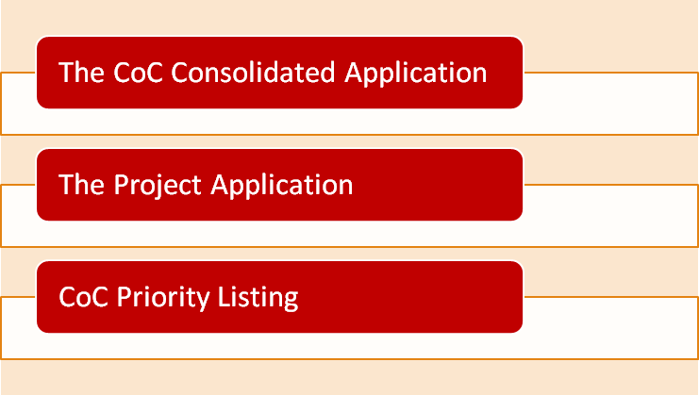
Three Components

Slide 7
Important CoC Program Guidance:
Application Packet Information Guidance
https://discover.pbcgov.org/communityservices/humanservices/PDF/RFP/2023/2023_COC_Program_Local_Renewal_Project_Application_72723_FINAL.pdf
https://discover.pbcgov.org/communityservices/humanservices/PDF/RFP/2023/2023_COC_Program_Local_NEW_Project_Application_72723_Final_Draft_628.pdf
Continuum of Care Program Interim Rule
https://www.hudexchange.info/resource/2033/hearth-coc-program-interim-rule/
CFR Part 200-Uniform Administrative Requirements, Cost Principles and Audit Requirements for Federal
Awards https://www.ecfr.gov/cgi-bin/text-idx?tpl=/ecfrbrowse/Title02/2cfr200_main_02.tpl
2022 New/Renewal Project Application Navigational Guide : (2023 Guides have not yet been released)
https://www.hud.gov/sites/dfiles/CPD/documents/CoC/FY-2022-CoC-Application-Navigational-Guide.PDF
https://www.hud.gov/sites/dfiles/CPD/documents/CoC/FY-2022-New-Project-Application-Navigational-Guide.PDF
2023 Renewal Project Detailed Instructions
https://www.hud.gov/sites/dfiles/CPD/documents/CoC/FY-2023-CoC-RENEWAL-Application-Detailed-Instructions.pdf
2023 New Project Detailed Instructions
https://www.hud.gov/sites/dfiles/CPD/documents/CoC/FY-2023-CoC-NEW-Application-Detailed-Instructions-7-31-2023.pdf
HUD Navigational Guides are not yet available

Slide 8
Noteworthy Changes
  Tier 1 is smaller this year
  CoC Bonus amounts for new projects are higher
  CoC Planning grant amounts are higher
  Increase in number of RRH Beds Rating Factor
  YHDP is allowing renewal or replacement for 1st round YHDP
  HUD added new budget line items for new eligible CoC activities
    VAWA
    Rural Costs Budget Line Items
  The VAWA Reauthorization Act of 2022

Slide 9
Fatal Flaws
If an agency fails to submit the application by August 28, 2023 by 12:00 p.m. Noon, EST, the project will not be ranked or considered for CoC Program Competition funding. There will be NO exceptions made.

Slide 10

CoC Non-Conflict Grant (NCG) Review Committee Meeting: September 8, 2023

Slide 11
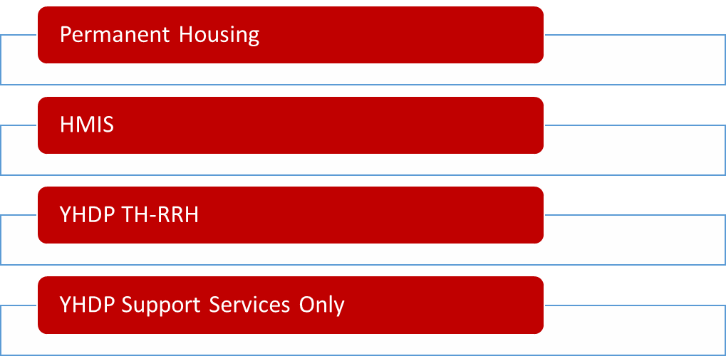
Scope of Services
Term of CoC funded programs is 12 months

Slide 12
Local Priorities
HHA’s local priority projects include:
PSH and RRH projects
TH-RRH projects only if previously funded through YHDP for
Youth ages 18-24
SSO projects only if previously funded through YHDP for Youth ages 18-24
HHA local priority populations, in order of priority, are:
1. Seniors
2. Chronic Individuals
3. Domestic Violence
4. Youth
5. Veterans
6. Families

Slide 13

1.Cover Sheet and Instructions Certification signed and dated
2.Copy of Renewal from eSnaps
3. CoC Grantee Certification signed and dated
4. Match Documentation Form
5. Letter explaining any issue there may be
5. Copy of grant agreement from previous grant year
6. eLOCCS Screen documenting expended funds to date
7. Agency Budget
8. Most Recent HUD Monitoring Report
9. Current Independent Audited Financial Statement & Management Letter
Renewal Application Checklist

Slide 14
1.Cover Sheet and Instructions Certification signed and dated
2.Copy of New RRH and/or PSH Project Application from eSnaps
3. CoC Grantee Certification signed and dated
4. Match Documentation Form
5. Letter explaining any issue that may be unique to items requested
6, Most Recent HUD Monitoring Report or other.
9. Current Independent Audited Financial Statement & Management Letter
10. eLOCCS Screen shot of Project Portfolio OR those applicants with no current
HUD funding
must provide a letter stating there is no current HUD funding
11. Organizational Chart
12. Agency Budget
13. Board of Director's List
14. Board of Director's Minutes
New Application Checklist

Slide 15
YHDP Prorgrams
YHDP grants will be renewed non-competitively and will not be scored or ranked
YHDP grantees must submit a renewal application (and answer all the questions!)
YHDP grantees can submit “replacement grant” applications
Allows existing grantees to change program types and make budget changes
Must receive letter of support from statewide YAB
Must be approved by the HHA Governance Board

Slide 16
Total Bonus Available (CoC + DV): estimating around $1,362,932 combined
Applicants go through the scoring and ranking process
Couple of notes…
CoC Bonus: Scoring & Ranking will look for new or expansion projects that include documented partnerships with healthcare and other housing funding sources
DV Bonus: used for new DV-specific project applications where 100% of the participants are or will be survivors of domestic violence, dating violence, sexual assault, or stalking.
New Projects

Slide 17
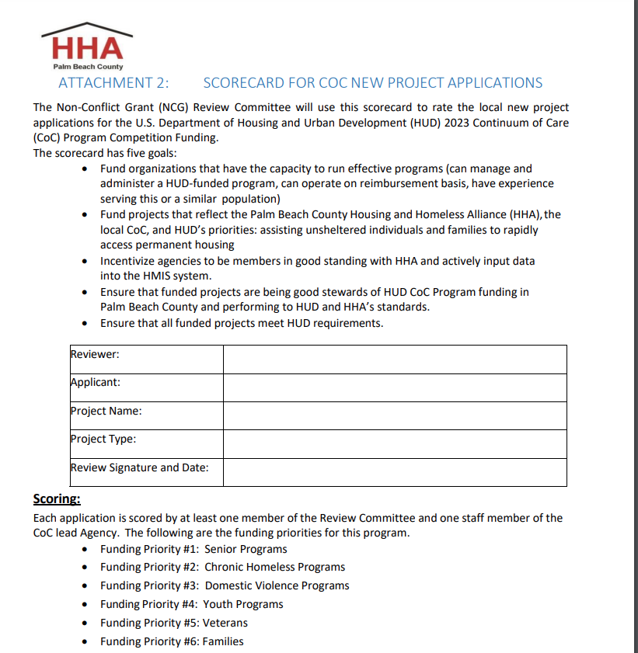
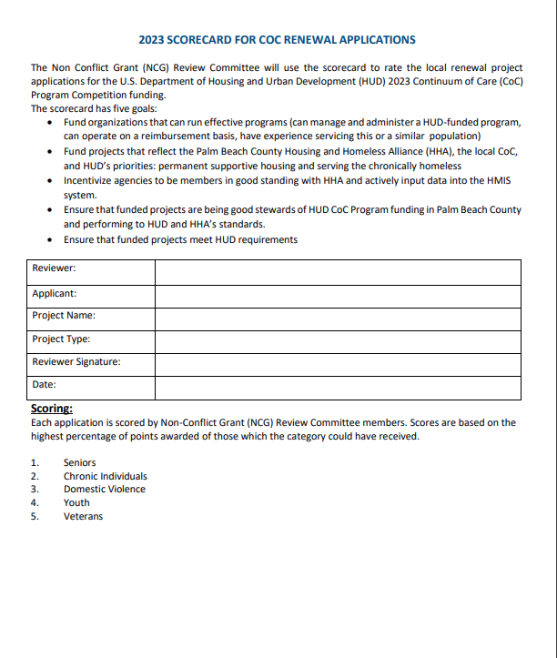
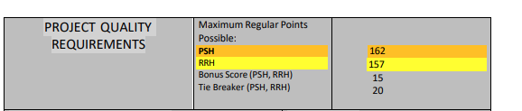

Scoring Tool Summary Review

Slide 18
Threshold
Required but not scored. If the applicant is ineligible to meet any of the standards within the threshold criteria, the project may be ineligible to go any further in the competition. If at any point during the competition it is determined that a threshold criteria has not been met, HUD or the HHA may find the applicant ineligible for HUD funding. Additional information may be requested with an explanation submitted for review by HSCA staff and HHA Governance Board.

Slide 19
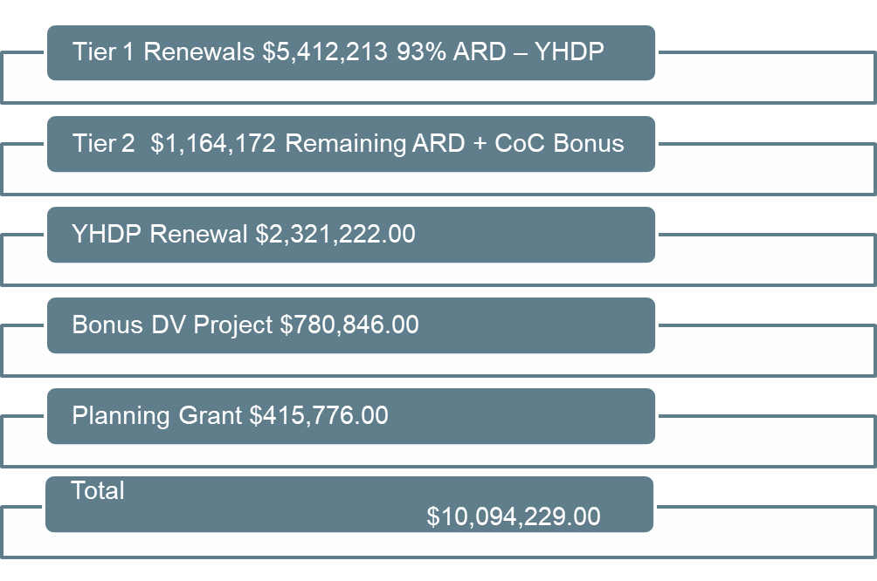
Available Dollars

Slide 20
Programs/to be Reallocated
  Project Succeed PSH $1,294,322
  Beacon Place PSH $806,594
  Home Run 2 PSH $628,968
  $2,729,884.00

Slide 21
Reallocation Practices
Criteria for reallocation
  The HHA may reduce or reject a funding request from a project applicant. For renewal projects, this is considered reallocation. Reallocation may be required for any of the following reasons:
  Failure to meet any threshold criteria for grantees of the HUD CoC Program
  Outstanding obligation to HUD that is in arrears or for which a payment schedule has not been agreed upon Audit finding(s) for which a response is overdue or unsatisfactory
  History of inadequate financial management accounting practices
  Evidence of untimely expenditures on prior award
  Evidence of noncompliance with HUD and/or CoC policies, including coordinated entry and written standards for assistance
  History of other major capacity issues that have significantly impacted the operation of the project and its performance
  History of serving ineligible persons, expending funds on ineligible costs, or failing to expend funds within statutorily established timeframes
  Failing to consistently meet the CoC performance measures, e.g. low score in the evaluation process
  Failing to provide documentation required by the CoC local competition for a project application or project review in the time or manner required
  Applicant choice to voluntarily reallocate all or a part of its award

Slide 22
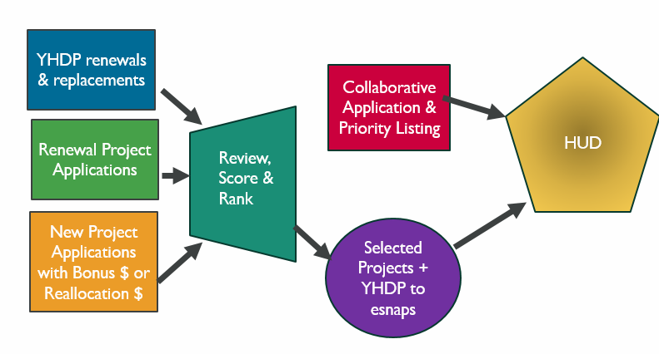
NOFO Process

Slide 23
Staff Contact
Maria Bond, Homeless Program and Contract Manager
mbond@pbcgov.org

Slide 24
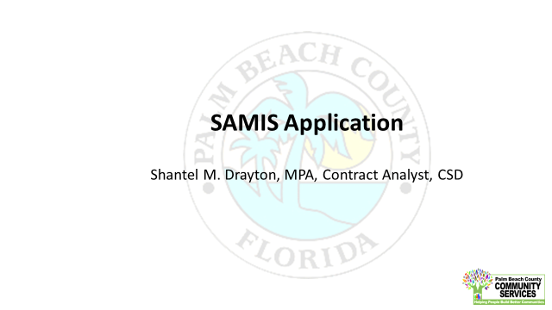

Slide 25
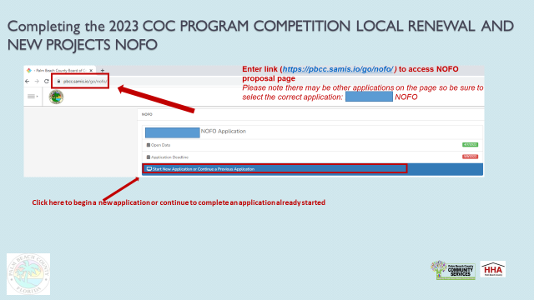

Slide 27
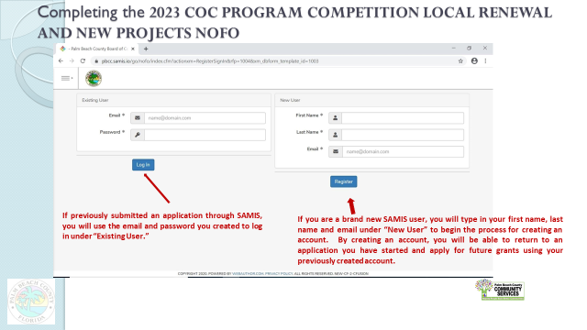

Slide 28
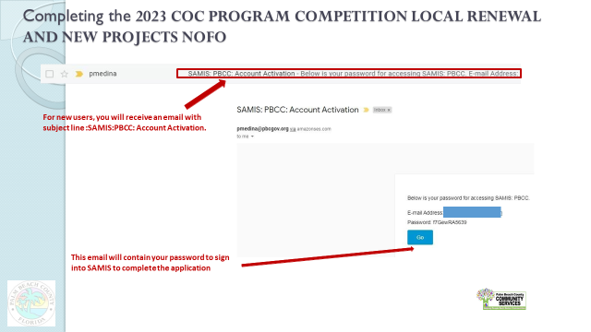

Slide 29
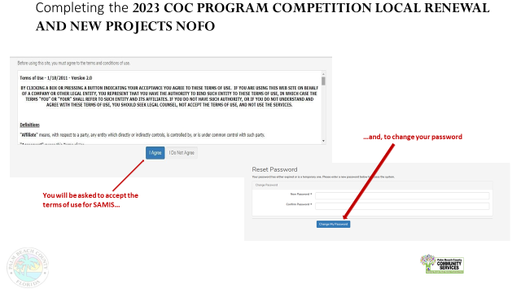

Slide 30
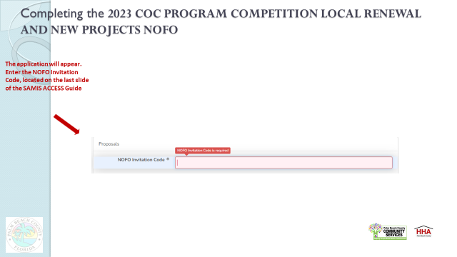

Slide 31
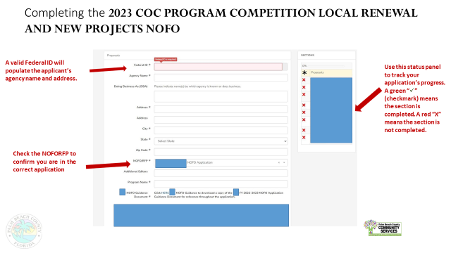

Slide 32
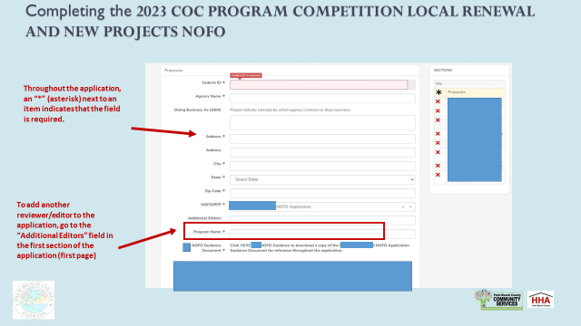

Slide 33
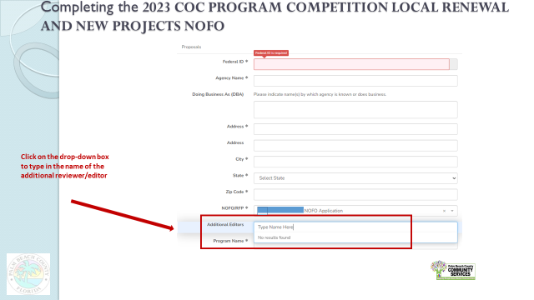

Slide 34
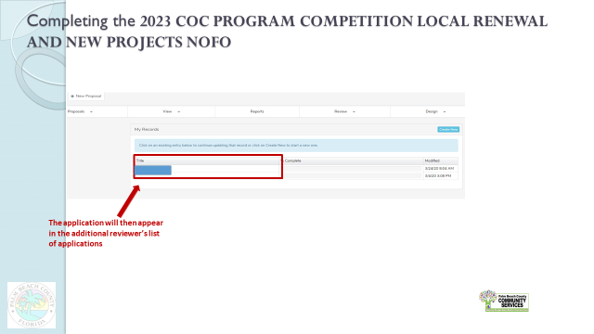

Slide 35
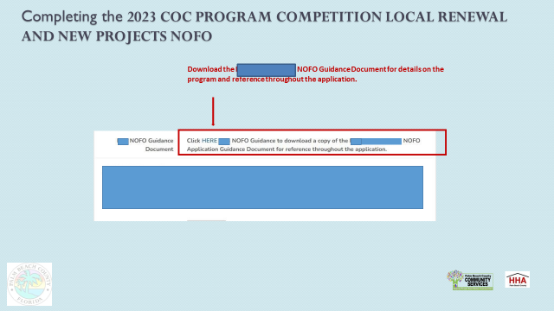

Slide 36
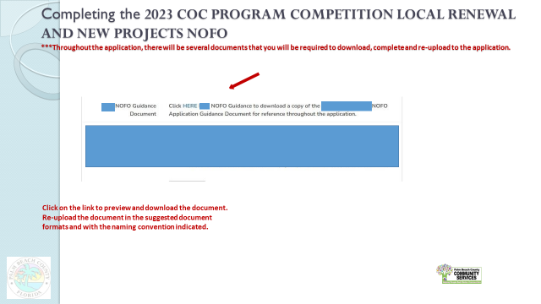

Slide 37
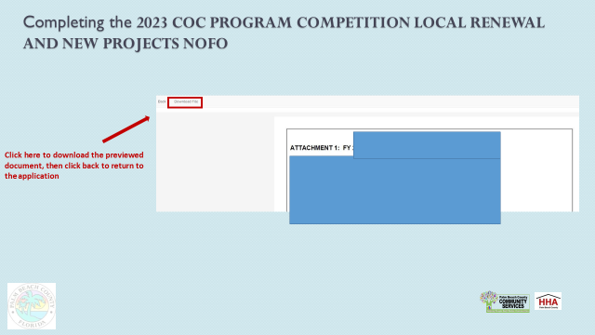

Slide 38
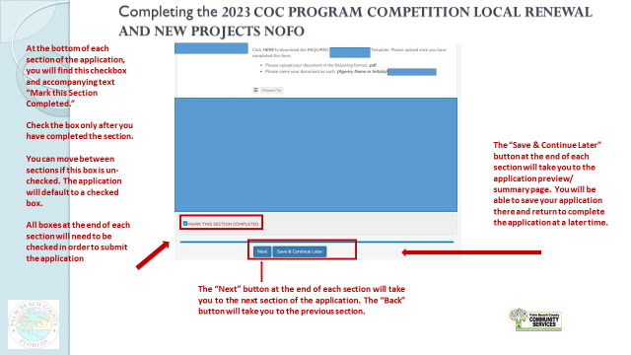

Slide 39
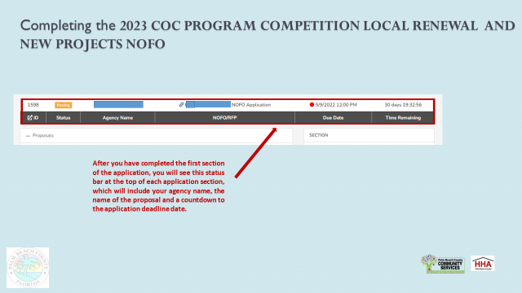

Slide 40
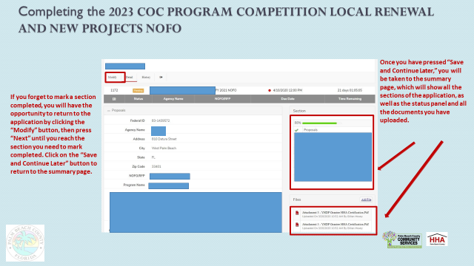

Slide 41
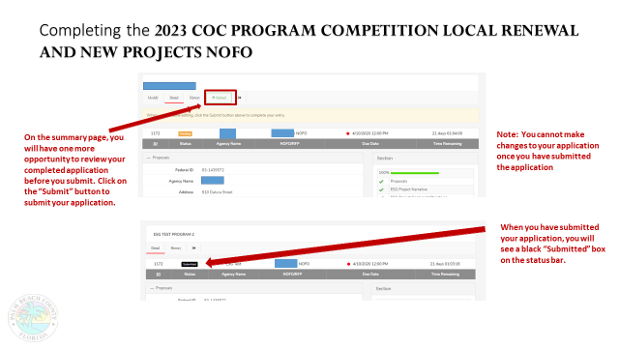

Slide 42
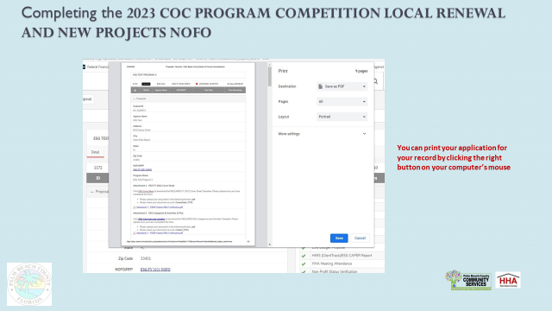

Slide 43
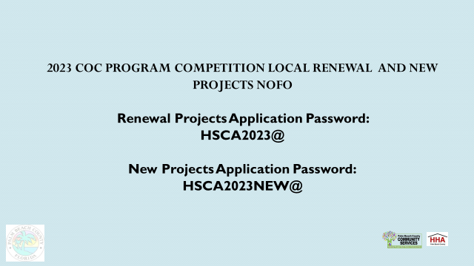

Slide 44


