Slide 1




Emergency Solutions Grant (ESG) Program
FY 2026-2027 Notice of Funding Opportunity (NOFO) Technical Assistance Meeting

Slide 2


Purpose of the ESG Grant
The federal Emergency Solutions Grant program (ESG) provides funds for a variety of activities to address homelessness as authorized under the federal Homeless Emergency Assistance and Rapid Transition to Housing (HEARTH) Act of 2009 and State program requirements.
Palm Beach County Homeless and Housing Alliance has prioritized and authorized applications for the following priorities in Palm Beach County;
a) Emergency Shelter ($277,410)
b) Rapid Re-Housing ($184,939)

Slide 3

ESG Definitions of Emergency Shelter
Emergency Shelter
Renovation, including major rehabilitation or conversion, of a building to serve as an emergency shelter. The emergency shelter must be owned by a government entity or private nonprofit organization. The shelter must serve homeless persons for at least 3 or 10 years, depending on the type of renovation and the value of the building. Note: Property acquisition and new construction are ineligible ESG activities.
Essential Services, including case management, child care, education services, employment assistance and job training, outpatient health services, legal services, life skills training, mental health services, substance abuse treatment services, transportation, and services for special populations.
Shelter Operations, including maintenance, rent, repair, security, fuel, equipment, insurance, utilities, food, furnishings, and supplies necessary for the operation of the emergency shelter. Where no appropriate emergency shelter is available for a homeless family or individual, eligible costs may also include a hotel or motel voucher for that family or individual.
See 24 CFR 576.102.

Slide 4
Definition of Rapid Re-Housing for ESG
Housing relocation and stabilization services and/or short-and/or medium-term rental assistance as necessary to help individuals or families living in shelters or in places not meant for human habitation move as quickly as possible into permanent housing and achieve stability in that housing.
Eligible costs include:
Rental Assistance: rental assistance and rental arrears
Financial Assistance: rental application fees, security and utility deposits, utility payments, last month's rent, moving costs
Services: housing search and placement, housing stability case management, landlord-tenant mediation, tenant legal services, credit repair
See 24 CFR 576.104

Slide 5
Application Deadline for ESG FY 2026-2027
Applications are due by 12:00 pm, Monday, April 27, 2026 EST.
Applications are submitted via the website listed in the NOFO
Questions regarding the application will be accepted until 12:00 pm noon on April 24, 2026.
Cone of Silence in effect until approximately July 7, 2026 (BCC meeting to approve recommendations)
Contracts will begin 10/01/2026 and End 09/30/2027, with an option to renew for two more years contingent on available funding.

Slide 6
CONE OF SILENCE
This NOFO includes a Cone of Silence. The Cone of Silence will apply from the Electronic Submission Deadline Date and terminate at the time the awards are approved by the Board of County Commissioners.
Proposers are advised that the “Palm Beach County Lobbyist Registration Ordinance” (Ordinance), a copy of which can be accessed at https://pbcgov.org/legislativeaffairs/Misc_Documents/Lobbyist_Registration _Ordinance.pdf, is in effect. The Proposer shall read and familiarize themselves with all the provisions of said Ordinance, but only for convenience, the provisions relating to the Cone of Silence are summarized here.
“Cone of Silence” means a prohibition on any non-written communication regarding this NOFO between any Proposer or Proposer’s representative and any County Commissioner or Commissioner’s staff. A Proposer’s representative shall include, but is not limited to, the Proposer’s employee, partner, officer, director or consultant, lobbyist, or any, actual or potential subcontractor or consultant of the Proposer.

Slide 7
CONE OF SILENCE
When Does the Cone of Silence End?
The Cone of Silence is in effect as of the Electronic Submission Deadline Date. The Cone of Silence shall terminate at the time that the BCC approves awards or contracts, all proposals are rejected, or other action is taken which ends the solicitation process.
When Oral Communications are Allowed?
The provisions of this Ordinance shall not apply to oral communications at any public meeting, including but not limited to pre-proposal conferences, and selection committee meetings. The Cone of Silence shall not apply to contract negotiations between any employee and the intended awardee.
Ethics Commission
If anyone has a question regarding ethics, they should not be addressed to our department, but should be addressed directly with the Ethics Commission. http://www.palmbeachcountyethics.com/

Slide 8
ESG Contracted Agency Requirement Highlights
Must be a member, within one month of funding, of the Homeless and Housing Alliance ( HHA), the local Continuum of Care for PBC.
Must adhere to the Standards of Care for component applied for as adopted by the HHA.
Must be an HHA member in Good Standing ( 60% of general HHA meetings and 70% of at least one subcommittee meeting).
Must participate in the Homeless Management Information System (HMIS). All ESG recipient information must be entered into and exited out of the HMIS system. Exceptions are in place for the agencies specializing in Domestic Violence.
Participate in the Annual Point in Time (PIT) Count as an agency.
Complete the Homeless Inventory Chart (HIC) for HUD as required.

Slide 9
ESG FY 2023-2024 Match Requirements
ESG grants require a dollar for dollar match. Please reference the ESG Interim Rule, Section 24 CFR 576.201, as referenced in the grant application, for further match requirements.
Matching funds must be clearly identified in your budget documentation.
Successful applicants must comply with the Unified Grant Guidance, 200 CFR Part 200 Uniform Administrative Requirements, Cost principles and Audit Requirement for Federal Awards.

Slide 10
ESG Program Requirement Highlights
Income limits for recipients of ESG funds only apply to those served in Prevention. Since this NOFO will only serve people in Emergency Shelter and Rapid Rehousing, income limits do not apply.
Emergency Solutions Grant ( ESG) does not use the Waivers that were issued for the ESG-CARES or CV dollars.
Agency must have policies and procedures for ESG funding and programming
RRH and Emergency Shelter must use the Coordinated Entry System as established by the HHA.

Slide 11
United States Department of Housing and Urban Development (HUD)
Please read the HUD program guidance and tools for ESG before writing the application (https://www.hudexchange.info/programs/esg/ )
Housing Quality Inspections must be done for Rapid Re-Housing Units
Shelters, if not owned by the County, must obtain a zoning compliance letter from the municipality to which the shelter is in.
Please read the HUD program guidance on type of rental assistance for RRH, Tenant Based or Project Based. Please indicate in your application which type of RRH assistance will be given.
HUD posted an Indirect Cost manual for CoC and ESG funding. Please look at manual prior to submitting indirect costs. https://www.hudexchange.info/news/new-indirect-cost-toolkit-for-coc-and-esg-programs/

Slide 12
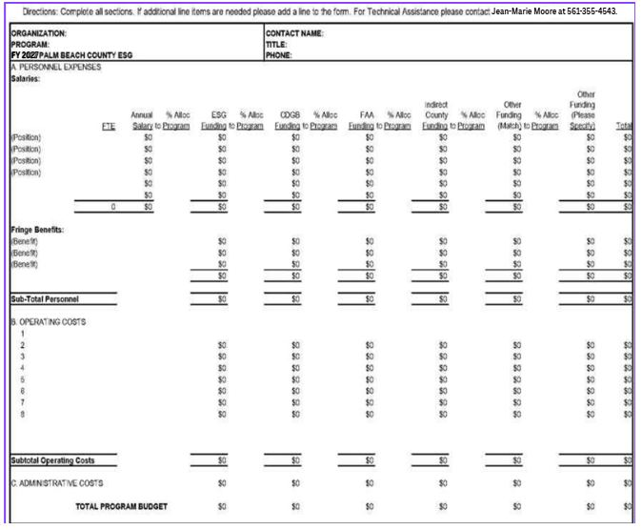
Budget Template

Slide 13
SAMIS System
Elcana Dantzler, Contracts/Grants Coordinator, will present the SAMIS ESG Grant Application requirements.

Slide 14
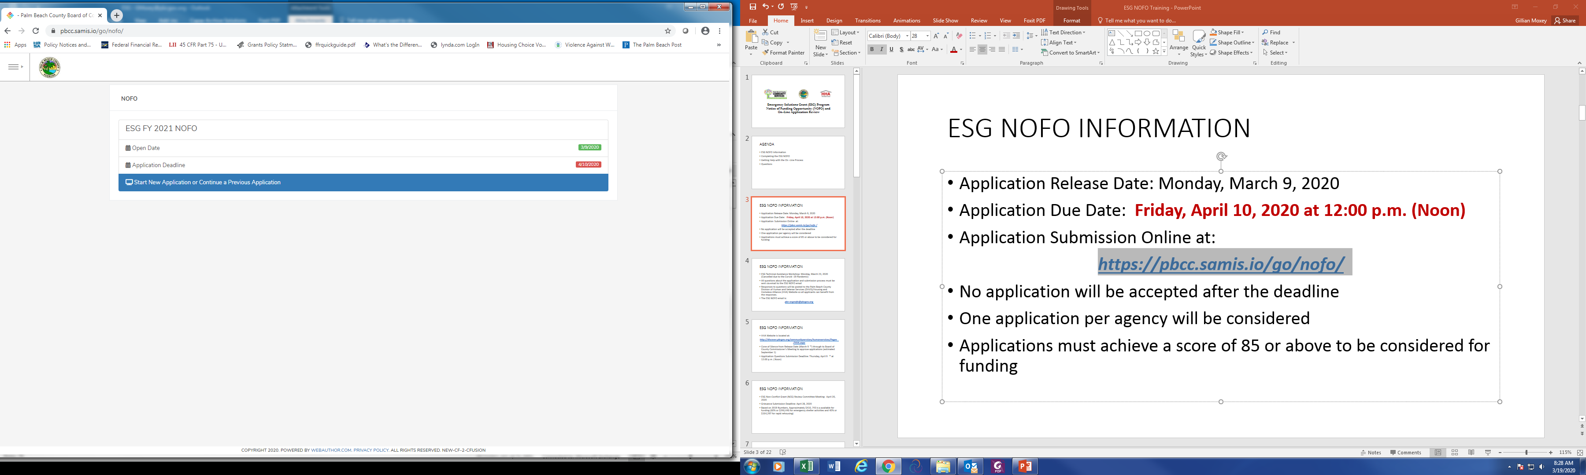
Completing the ESG NOFO
Enter link (https://pbcc.samis.io/go/nofo/ ) to access NOFO proposal page
Please note there may be other applications on the page so be sure to select the correct application: ESG FY 2023 NOFO
Click here to begin a new application or continue to complete an application already started

Slide 15
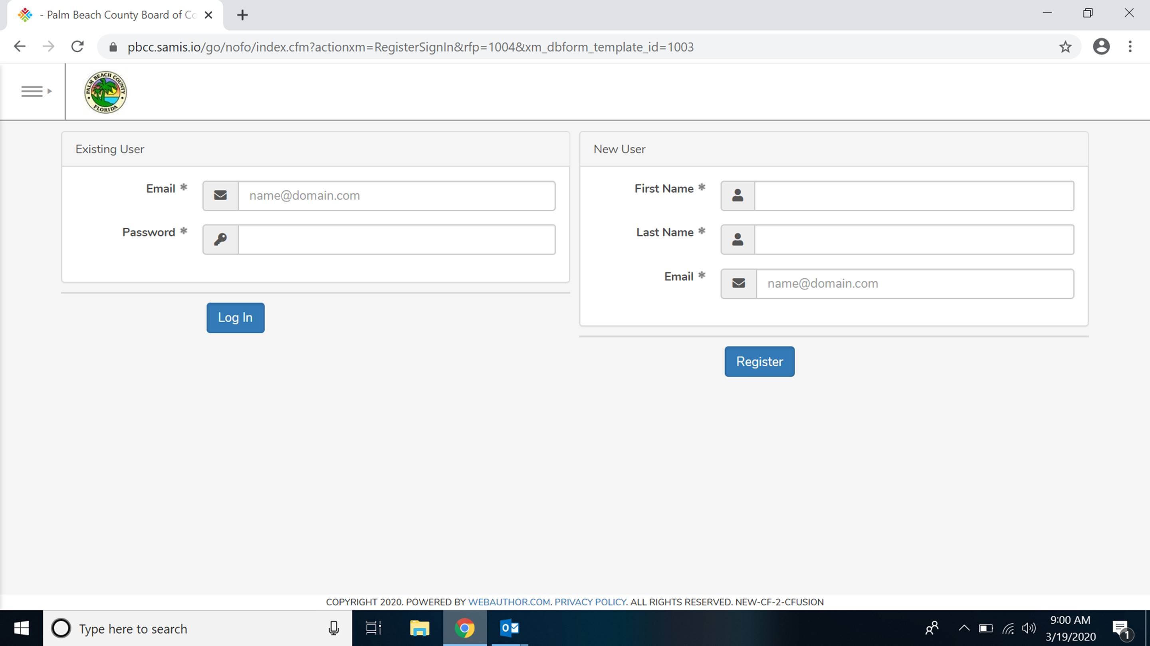
Completing the ESG NOFO
If previously submitted an application through SAMIS, you will use the email and password you created to log in under “Existing User.”
If you are a brand new SAMIS user, you will type in your first name, last name and email under “New User” to begin the process for creating an account. By creating an account, you will be able to return to an application you have started and apply for future grants using your previously created account.

Slide 16
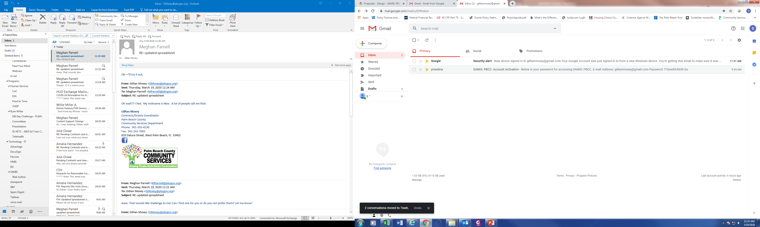
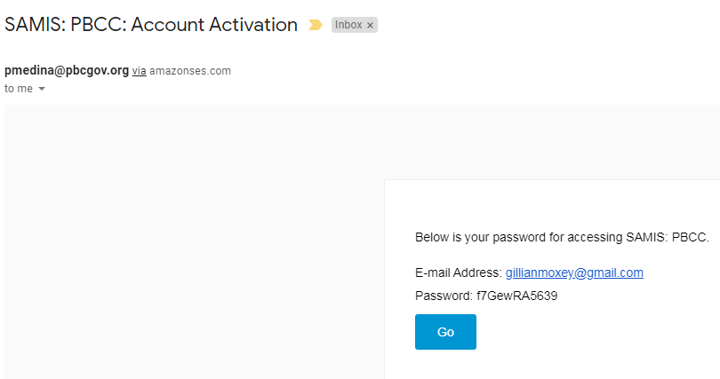
Completing the ESG NOFO
For new users, you will receive an email with subject line :SAMIS:PBCC: Account Activation.
This email will contain your password to sign into SAMIS to complete the application

Slide 17
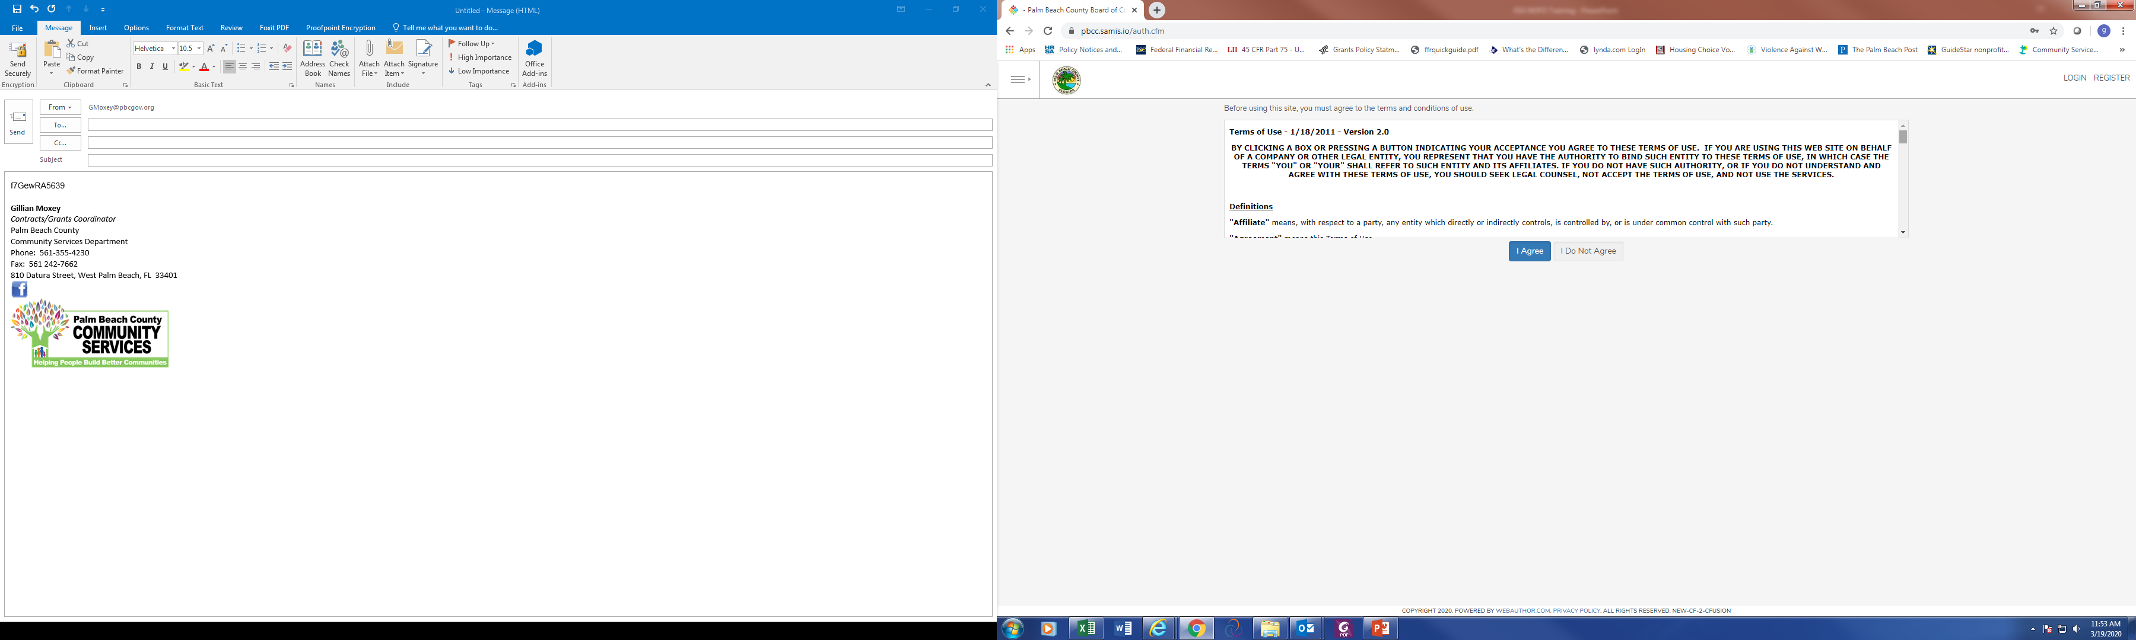
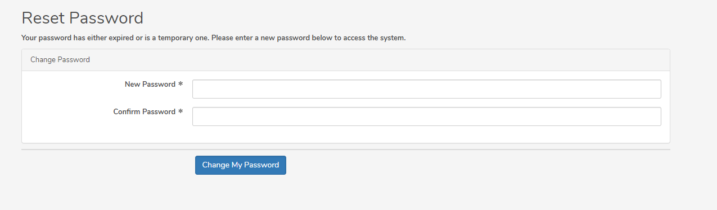
Completing the ESG NOFO
…and, to change your password
You will be asked to accept the terms of use for SAMIS…

Slide 18
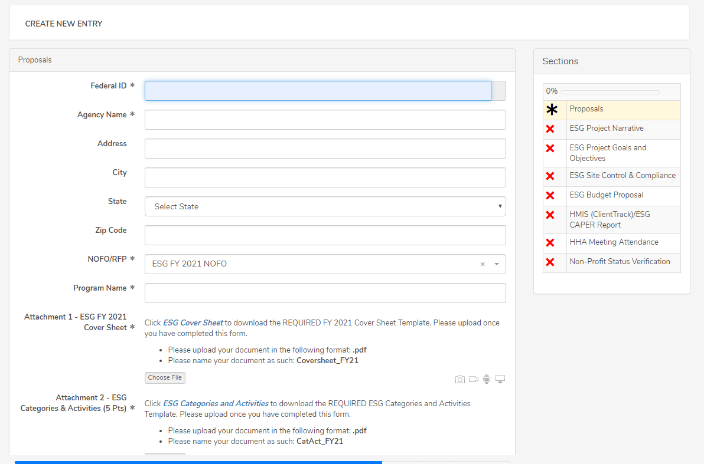
Completing the ESG NOFO
Use this status panel to track your application’s progress. A green “✓” (checkmark) means the section is completed. A red “X” means the section is not completed.
The application will appear. A valid Federal ID will populate the applicant’s agency name and address.
Check the NOFORFP to confirm you are in the correct application

Slide 19
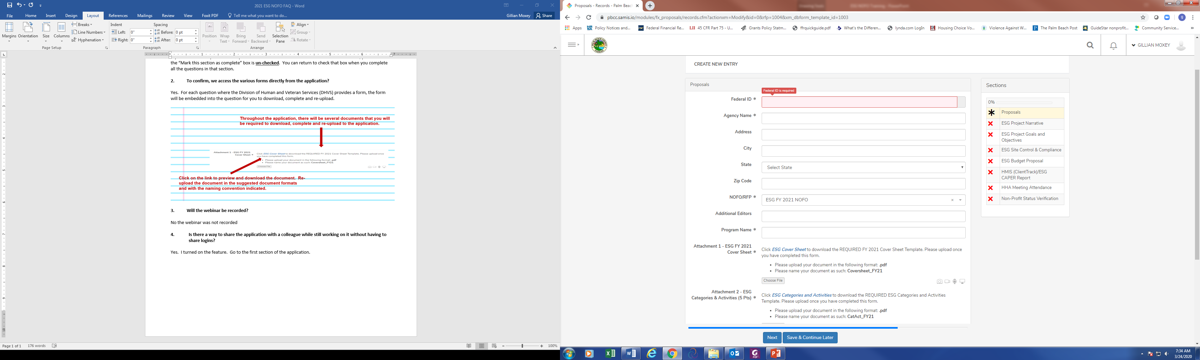

Completing the ESG NOFO
Throughout the application, an “*” (asterisk) next to an item indicates that the field is required.
To add another reviewer/editor to the application, go to the “Additional Editors” field in the first section of the application (first page)

Slide 20
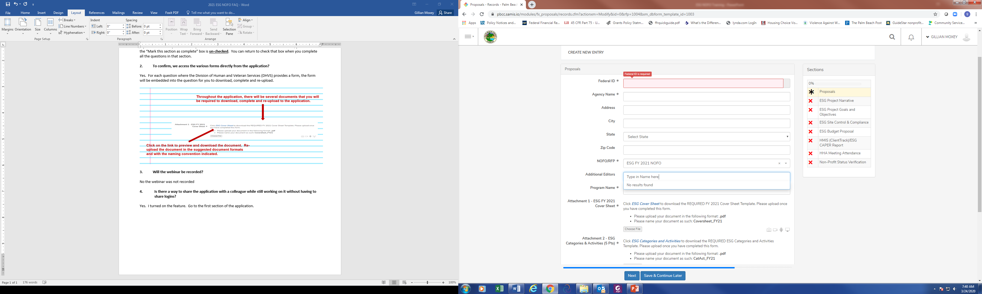
Completing the ESG NOFO
Click on the drop-down box to type in the name of the additional reviewer/editor

Slide 21
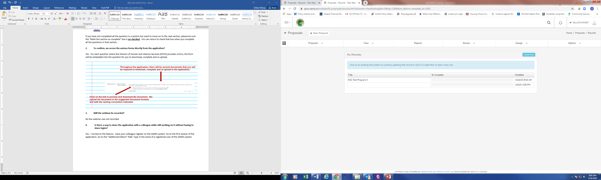
Completing the ESG NOFO
The application will then appear in the additional reviewer’s list of applications

Slide 22
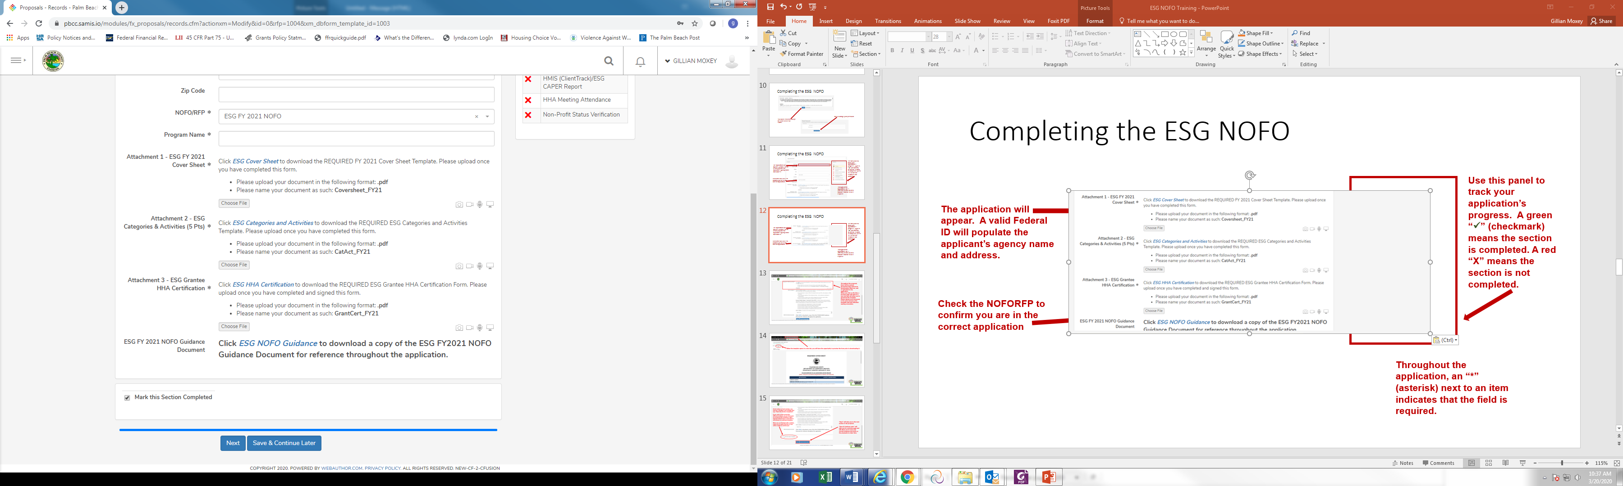
Completing the ESG NOFO
Download the ESG FY 2022 NOFO Guidance Document for details on the program and reference throughout the application.

Slide 23
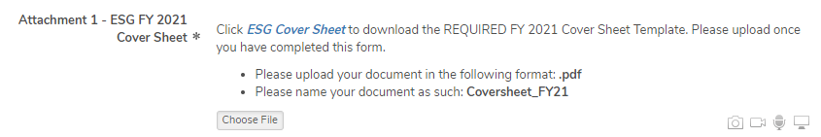
Completing the ESG NOFO
Throughout the application, there will be several documents that you will be required to download, complete and re-upload to the application.
Click on the link to preview and download the document. Re-upload the document in the suggested document formats and with the naming convention indicated.

Slide 24
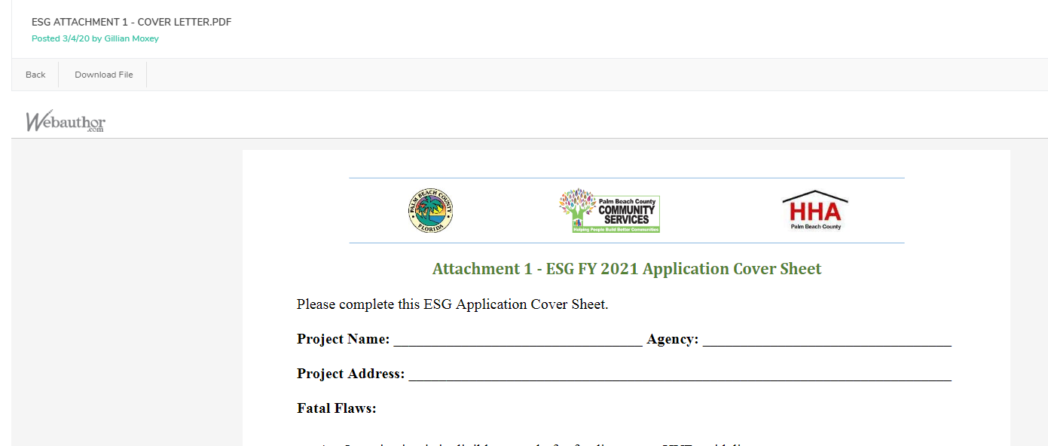
Completing the ESG NOFO
Click here to download the previewed document, then click back to return to the application

Slide 25
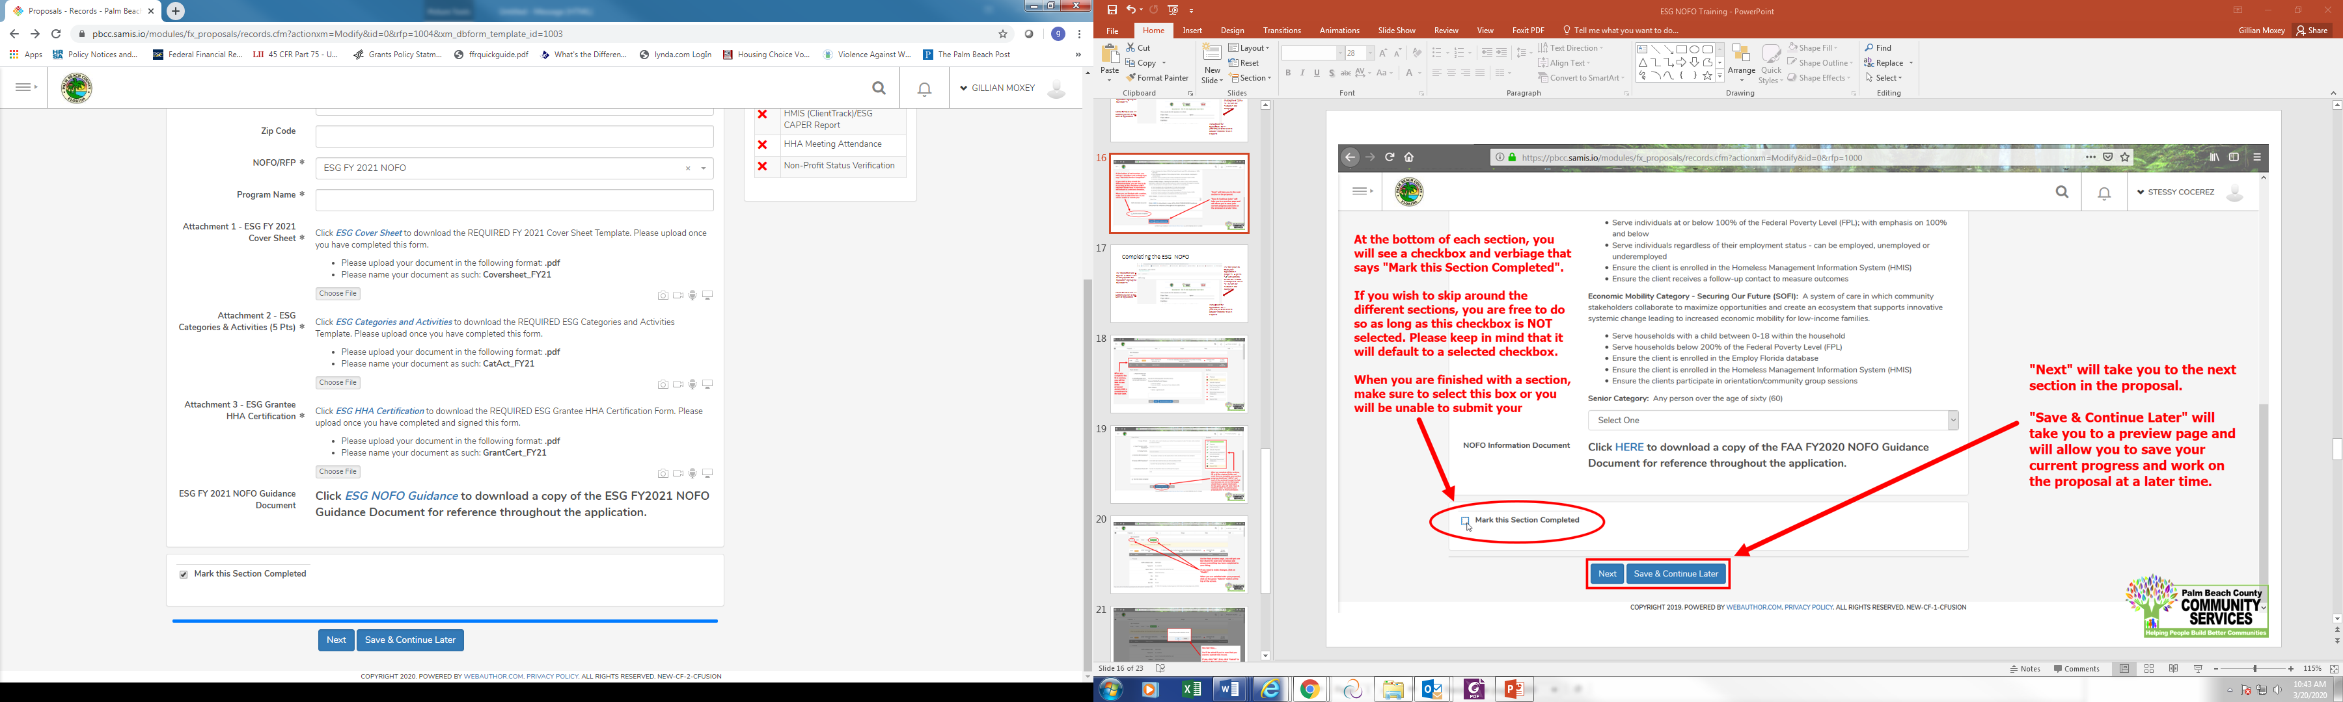
Completing the ESG NOFO
At the bottom of each section of the application, you will find this checkbox and accompanying text “Mark this Section Completed.”
Check the box only after you have completed the section.
You can move between sections if this box is un-checked. The application will default to a checked box.
All boxes at the end of each section will need to be checked in order to submit the application
The “Save & Continue Later” button at the end of each section will take you to the application preview/ summary page. You will be able to save your application there and return to complete the application at a later time.
The “Next” button at the end of each section will take you to the next section of the application. The “Back” button will take you to the previous section.

Slide 26
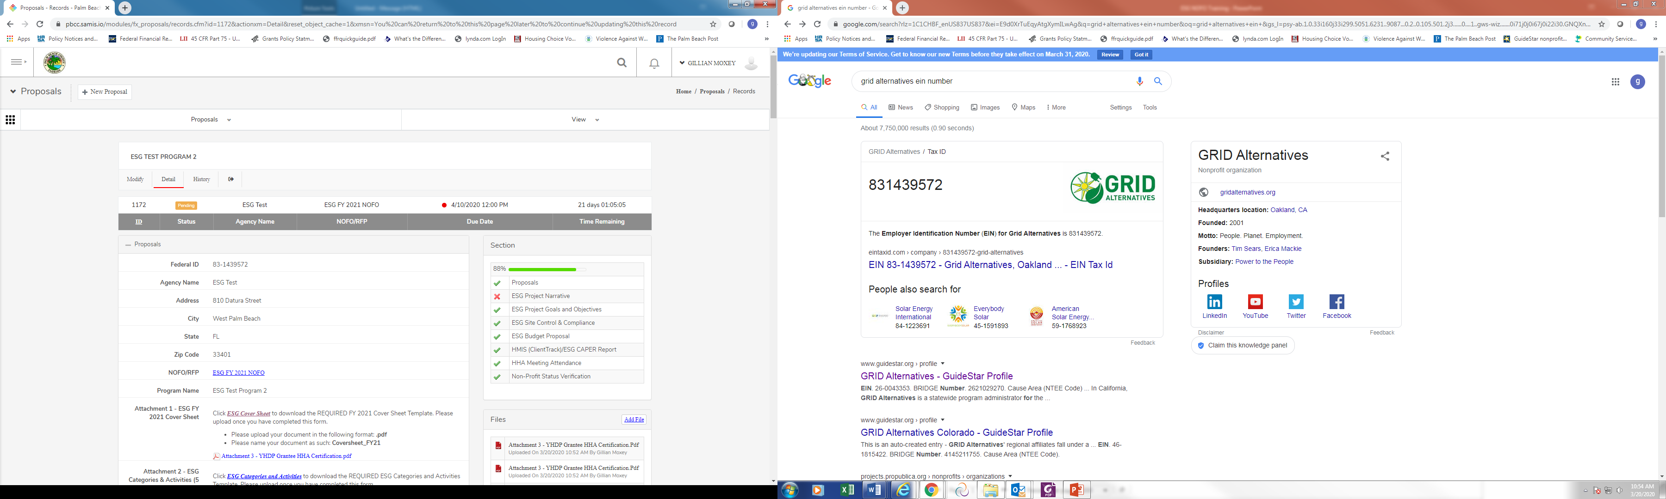
Completing the ESG NOFO
After you have completed the first section of the application, you will see this status bar at the top of each application section, which will include your agency name, the name of the proposal and a countdown to the application deadline date.

Slide 27
Completing the ESG NOFO
Once you have pressed “Save and Continue Later,” you will be taken to the summary page, which will show all the sections of the application, as well as the status panel and all the documents you have uploaded.
If you forget to mark a section completed, you will have the opportunity to return to the application by clicking the “Modify” button, then press “Next” until you reach the section you need to mark completed. Click on the “Save and Continue Later” button to return to the summary page.

Slide 28
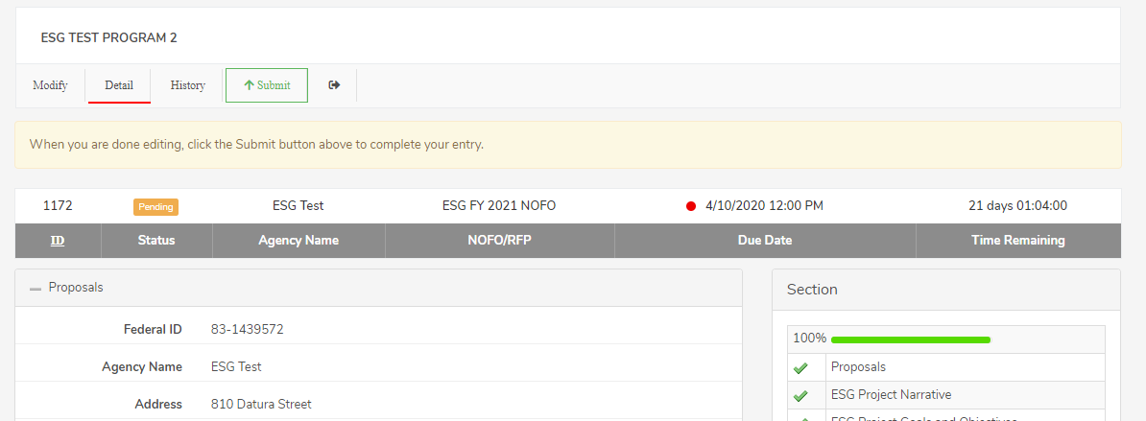
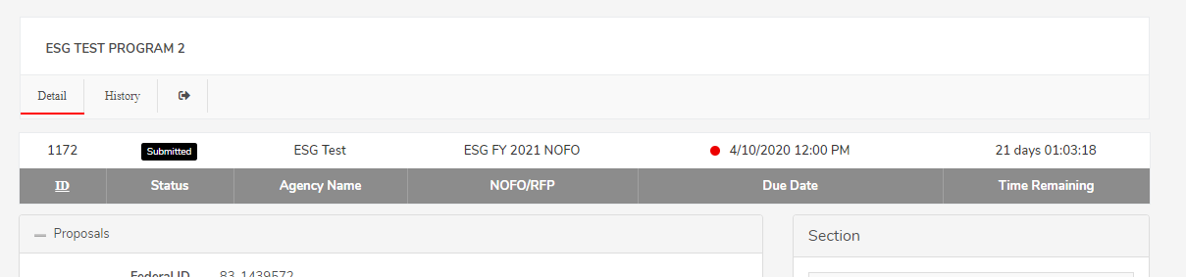
Completing the ESG NOFO
On the summary page, you will have one more opportunity to review your completed application before you submit. Click on the “Submit” button to submit your application.
Note: You cannot make changes to your application once you have submitted the application
When you have submitted your application, you will see a black “Submitted” box on the status bar.

Slide 29
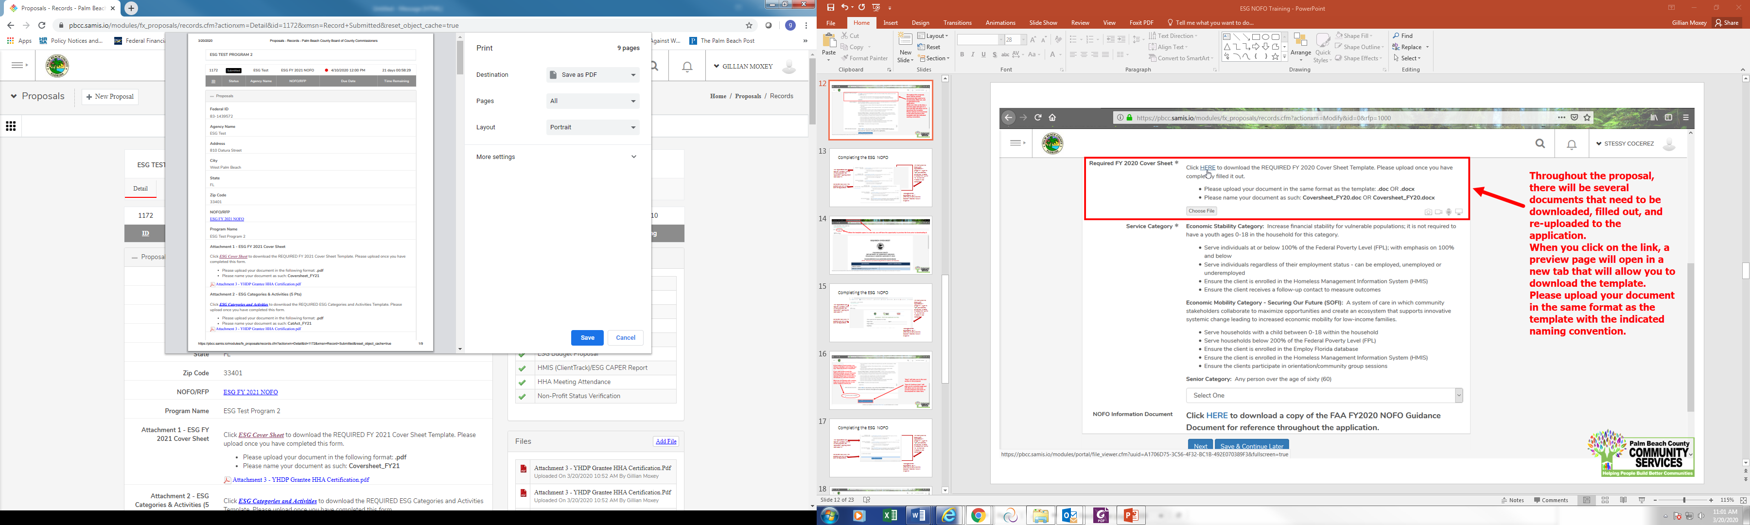
Completing the ESG NOFO
You can print your application for your record by clicking the right button on your computer’s mouse

Slide 30
QUESTIONS…

Slide 31
Staff Contact
If you have questions as you review the application, contact:
  Contact: Jennifer Sellars
  Email: PBC-ESGNOFO@PBC.GOV
  Call: 561.694.7466
NOFO Invitation Code: ESG2026

