Slide 1
Palm Beach County
Impact Fee Update Study
April 22, 2022

Slide 2
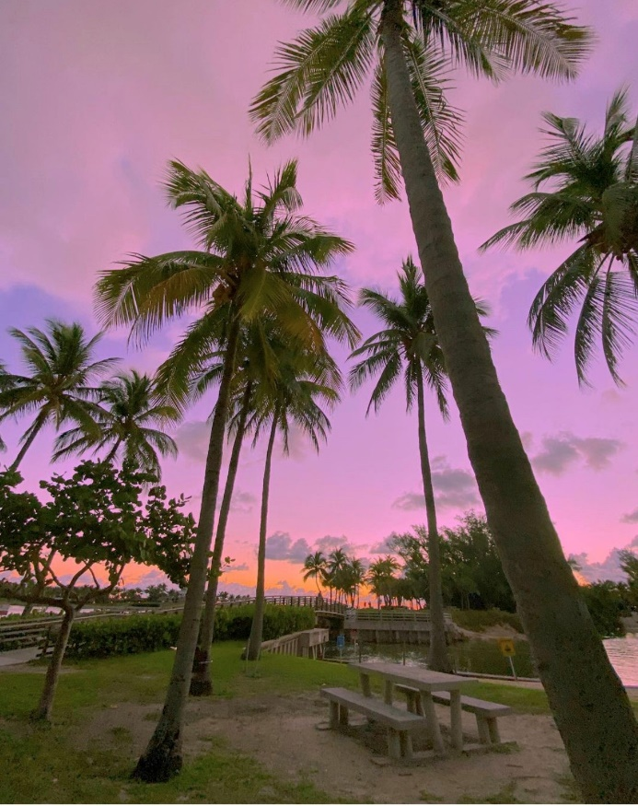
Presentation Overview
Background/Purpose
Technical Study
Fire Rescue
Summary
Next Steps

Slide 3
Background/Purpose
Palm Beach County:
3rd largest county in population out of 67 counties (1.5 million)
32nd in terms of population growth rate (0.8 percent per year through 2045)
5th in terms of absolute population growth
Projected to add 250,000 residents through 2045
10th in terms of residential permitting levels
Implemented impact fees in 1988
Last updated in 2014-2018
Most fees remained at 2012-study levels

Slide 4
Background/Purpose
Began updating the technical study in February 2021
Presented initial study findings on April 1, 2022
Recommended changes to fire rescue impact fee calculations
Review of station square footages
Removal of training facility from the inventory
Use of 2021 incident data
Include incidents in the Glades area

Slide 5
Presentation Overview
Background/Purpose
Technical Study
Fire Rescue
Summary
Next Steps

Slide 6
Fire Rescue

Slide 7
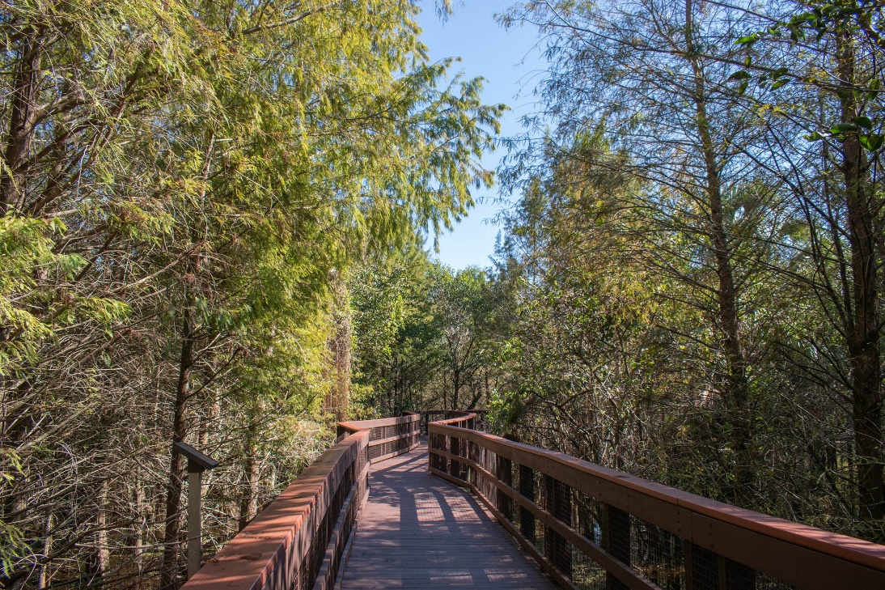
Fire Rescue
Impact Fee Components
Inventory
Level of Service
Cost Component
Credit Component
Net Impact Cost
Calculated Fee
Fee Comparison

Slide 8
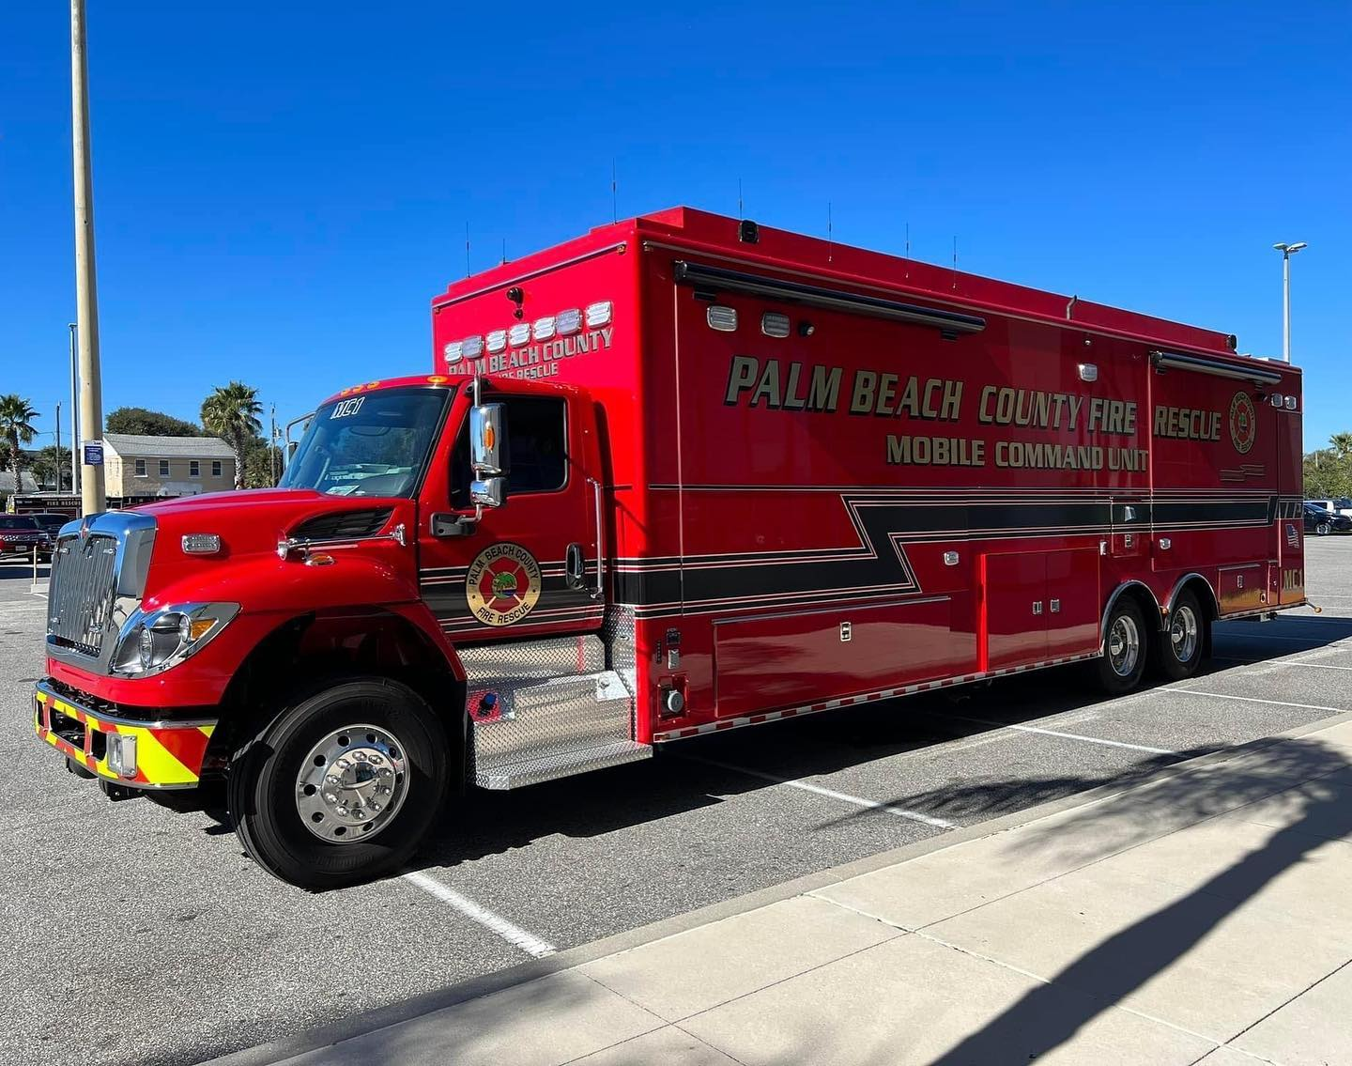
Fire Rescue
Inventory
43 Fire Rescue Stations
≈297,129 sf (from 387,000 sf)
≈89 acres of land (from 113 acres)
Vehicles/equipment
Unit Costs:
Land: $325,000 per acre
Buildings: $525 per square foot

Slide 9
Fire Rescue
Level of Service
Service Area: Unincorporated County & 19 Cities
Variable | Figure
Number of Stations | 43
Total Number of Incidents (2020) | 131,746 (from 114,642)
LOS (Incidents per Station) | 3,064 (from 2,666)

Slide 10
Fire Rescue
Cost Component
Variable | Figure (Revised) | Figure (Original) | % of Total Revised
Building Value | $156.0 M | $203.2 M | 50%
Land Value | $28.8 M | $36.8 M | 9%
Vehicle & Equipment Value | $130.0 M | $130.0 M | 41%
Total Asset Value | ≈ $314.7 M | ≈$370.0 M | 100%
Number of Incidents | 131,746 | 114,642 | -
Total Impact Cost per Incident | ≈$2,389 | ≈$3,227 | -

Slide 11
Fire Rescue
Credit Component: Annual Cash Credit
Variable | Total FY 2017-2021
Ad Valorem Funding | $3,212,665
Average Annual Capital Expansion Expenditures | $642,533
Average Annual Incidents | 124,431
Capital Expansion Expenditures per Incident | $5.16
Residential Land Uses Credit Adjustment Factor | 1.70
Residential Land Uses: Adjusted Capital Expansion Expenditures per Incident | $8.77

Slide 12
Fire Rescue
Credit Component: Total Credit
Variable | Credit (Revised) | Credit (Original)
Revenue Credit
Cash Credit per Incident
- Residential Land Uses | $8.77 | $9.50
- Non-residential Land Uses | $5.16 | $5.59
Capitalization Rate | 2.4% | 2.4%
Capitalization Period (in years) | 25 | 25
Total Credit
Total Capital Improvement Credit per Incident
- Residential Land Uses | $163.45 | $177.05
- Non-residential Land Uses | $96.17 | $104.18

Slide 13
Fire Rescue
Net Impact Cost
Variable | Figure (Revised) | Figure (Original)
Impact Cost
Total Impact Cost per Incident | $2,389 | $3,227
Revenue Credit
Total Credit per Incident
- Residential Land Uses | $163 | $177
- Non-Residential Land Uses | $96 | $104
Net Impact Cost
Net Impact Cost per Incident
- Residential Land Uses | $2,226 | $3,050
- Non-Residential Land Uses | $2,293 | $3,123

Slide 14
Fire Rescue
Calculated Impact Fee
Land Use | Unit | Calls for Service Coefficient* | Fully Calculated Fee (Revised) | Fully Calculated Fee (Original) | Current Adopted Fee | Maximum Allowable Fee**
Residential
Single Family (attached/detached/mobile home) | du | 0.2821 | $628 | $852 | $276 | $414
Multi-Family | du | 0.1717 | $382 | $518 | $185 | $277
Non-Residential
General Industrial | 1,000 sf | 0.0673 | $154 | $193 | $80 | $120
Office | 1,000 sf | 0.0370 | $85 | $114 | $50 | $75
General Retail | 1,000 sfgla | 0.0749 | $172 | $235 | $121 | $172
* Average of 2016-2019, 2021
**Over the next four years

Slide 15
Fire Rescue
Impact Fee Component Changes:
Input Variable | 2014-18 Study* | 2021 Study Revised | % Change
Single Family (per du)
Total Impact Cost per Incident | $1,285 | $2,389 | +86%
Total Credit per Incident | $165 | $163 | -1%
Net Impact Cost per Incident | $1,119 | $2,226 | +99%
Calls for Service Coefficient | 0.2601 | 0.2821 | +8%
Calculated Impact Fee | $291 | $628 | +116%
*Full calculated rate is shown for comparison purposes. Fee was adopted at 95% ($276)

Slide 16
Fire Rescue
Impact Fee Comparison
Land Use | Unit | Palm Beach County |  |  | Hillsborough County | Martin County | Miami-Dade County | Orange County | St Lucie County
Land Use | Unit | Current Adopted | Fully Calculated | Maximum Allowable* | Hillsborough County | Martin County | Miami-Dade County | Orange County | St Lucie County
Study Date | - | 2014-2018 | 2021 | N/A | 2018 | 2012 | N/A | 2017 | 2016
Assessed Portion | - | 95% | N/A | N/A | 100% | 100% | N/A | 100% | 100%
Residential
Single Family (2,000 sf) | du | $276 | $628 | $414 | $335 | $599 | $447 | $339 | $667
Multi-Family (1,300 sf) | du | $185 | $382 | $277 | $249 | $599 | $447 | $232 | $436
Non-Residential
General Industrial | 1,000 sf | $80 | $154 | $120 | $57 | $12 | $1,448 | $84 | $76
Office | 1,000 sf | $50 | $85 | $75 | $158 | $80 | $355 | $269 | $668
Retail | 1,000 sfgla | $121 | $172 | $172 | $313 | $319 | $478 | $307 | $536
*Over the next four years

Slide 17
Fire Rescue
Revenue Projections
Based on permitting levels from 2015+
Full calculated rates ≈$1.3 million per year
Max allowable rates ≈$0.9 million per year
Examples of projects eligible for impact fee funding
Agricultural Reserve North Fire Station (≈$7 M)
Agricultural Reserve South Fire Station (≈$6.2 M)
Southern Blvd 20 Mile Bend Station (≈$7.3 M)

Slide 18
Presentation Overview
Background/Purpose
Technical Study
Fire Rescue
Summary
Next Steps

Slide 19
Summary
Summary of Calculated Impact Fee Rates:
Land Use | Unit | Public Buildings | Fire Rescue | Law Enforcement | Library Facilities | Parks & Recreation | School Facilities | Transportation | Total Calculated | Total Adopted
Residential
Single Family (2,000 sf) | du | $1,573 | $628 | $230 | $311 | $2,967 | $8,322 | $5,892 | $19,923 | $13,055
Non-Residential
Light Industrial | 1,000 sf | $466 | $154 | $59 |  |  | - | $2,633 | $3,312 | $1,683
Office (50,000 sf) | 1,000 sf | $951 | $85 | $120 |  |  | - | $5,847 | $7,003 | $3,609
Retail (125,000 sfgla) | 1,000 sfgla | $2,503 | $172 | $315 |  |  | - | $8,323 | $11,313 | $8,170

Slide 20
Summary
HB 337 in 2021:
Limit on fee increases:
No more than 12.5% per year
Cannot be increased more than 50%
Cannot be increased more than once every four years
Exception:
A study within the past 12 months demonstrating extraordinary circumstances
Two public workshops to discuss the extraordinary circumstances
Increase to be approved by 2/3rd of the governing body

Slide 21
Summary
Summary of Maximum Allowable Impact Fee Rates:
Land Use | Unit | Public Bldgs | Fire Rescue | Law Enf | Library | Parks & Recr | School | Transp | Total Maximum Allowable* | Total Adopted
Residential
Single Family (2,000 sf) | du | $334 | $414 | $192 | $311 | $1,290 | $8,322 | $5,892 | $16,755 | $13,055
Non-Residential
Light Industrial | 1,000 sf | $110 | $120 | $11 |  |  | - | $2,284 | $2,525 | $1,683
Office (50,000 sf) | 1,000 sf | $196 | $75 | $15 |  |  | - | $5,127 | $5,413 | $3,609
Retail (125,000 sfgla) | 1,000 sfgla | $504 | $172 | $86 |  |  | - | $8,323 | $9,085 | $8,170
*Over the next four years

Slide 22
Presentation Overview
Background/Purpose
Technical Study
Fire Rescue
Summary
Next Steps

Slide 23
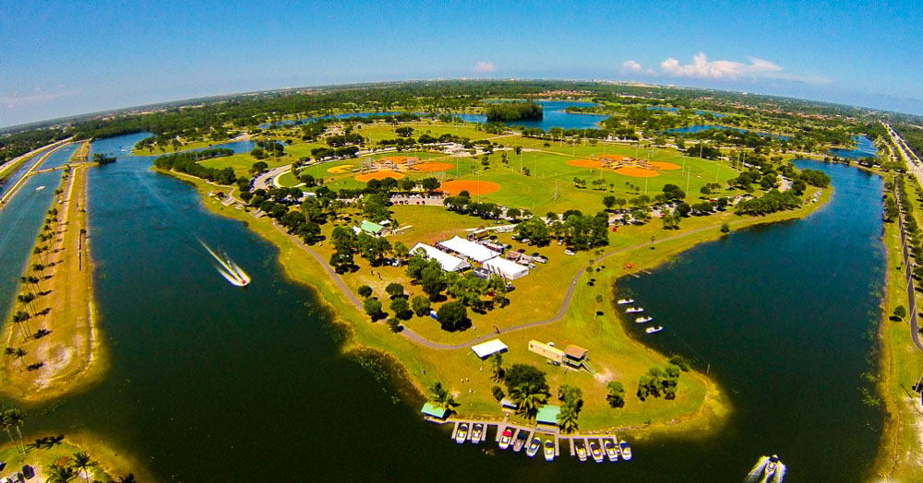
Next Steps
Impact Fee Review Committee Input
Final Technical Report
BOCC Workshop
Implementation Process

Slide 24
Questions?

